Slide 1


Making the
most of IT
Computing, learning technology and
library services for new students
Andy Todd | Angela Nicholson
Digital Skills and Training | Library Services
Notes:
Hello and welcome to this session on Making the most of IT.
This presentation provides an awareness of the Information Technology and library services available at the University of Edinburgh.
The presentation contains a lot of information, and some things may not be relevant to you now, but are likely to become relevant in a few weeks, or months, time as you progress with your studies. Hopefully, having seen this presentation, you’ll then remember about the services available to you and be able to find the information on the University website and get the full details.

Slide 2
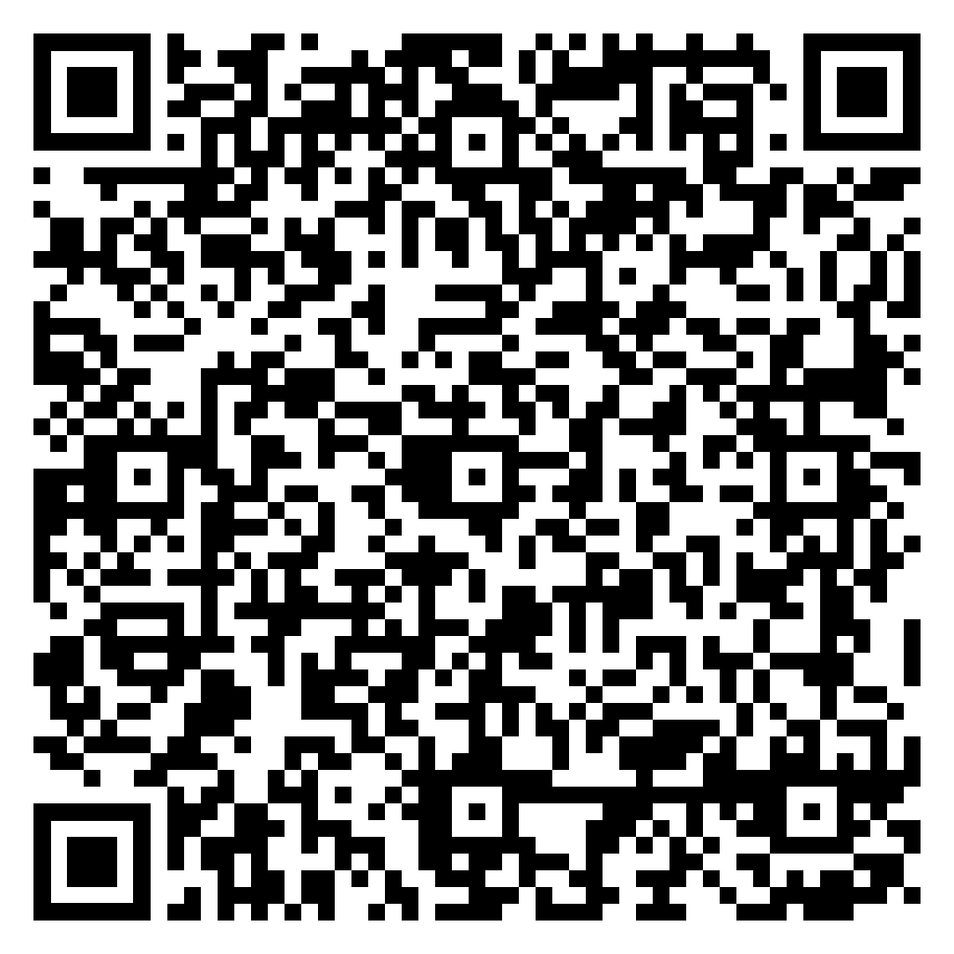
Presentation
and resources
You can view a pre-recorded version of this presentation, download a copy, and access
a list of the useful links on our Making
the Most of IT webpage by scanning this
QR code.
Alternatively, you can visit https://edin.ac/2XvCByf
Notes:
A full copy of today’s presentation as well as a pre-recorded version can be found on our dedicated Making the Most of IT webpage. You’ll also find a list of useful links on the topics covered today.
You can access this webpage using the link on this slide or by clicking or scanning the QR code.
We’ve also added QR codes to each slide which can be scanned or clicked on to take you to the relevant webpage with further information for the specific topic.
Content Link: https://edin.ac/2XvCByf

Slide 3
Agenda
Let’s take a closer look the main topics covered in this presentation.
Essential systems
and software
Computing and
printing services
Mobile
computing
Library
services
Digital Skills Programme
Help and
support
01
04
02
05
03
06
Notes:
During today’s presentation we will introduce you to the key services you should be aware of as a student. These include:
Essential systems and software
Computing and printing services
Mobile computing
Library services
Digital Skills Programme
Help and support

Slide 4

01
Essential systems
and software
Notes:
Let’s first take a look at some of the essential systems and software you need to know about as a new student at the University.

Slide 5
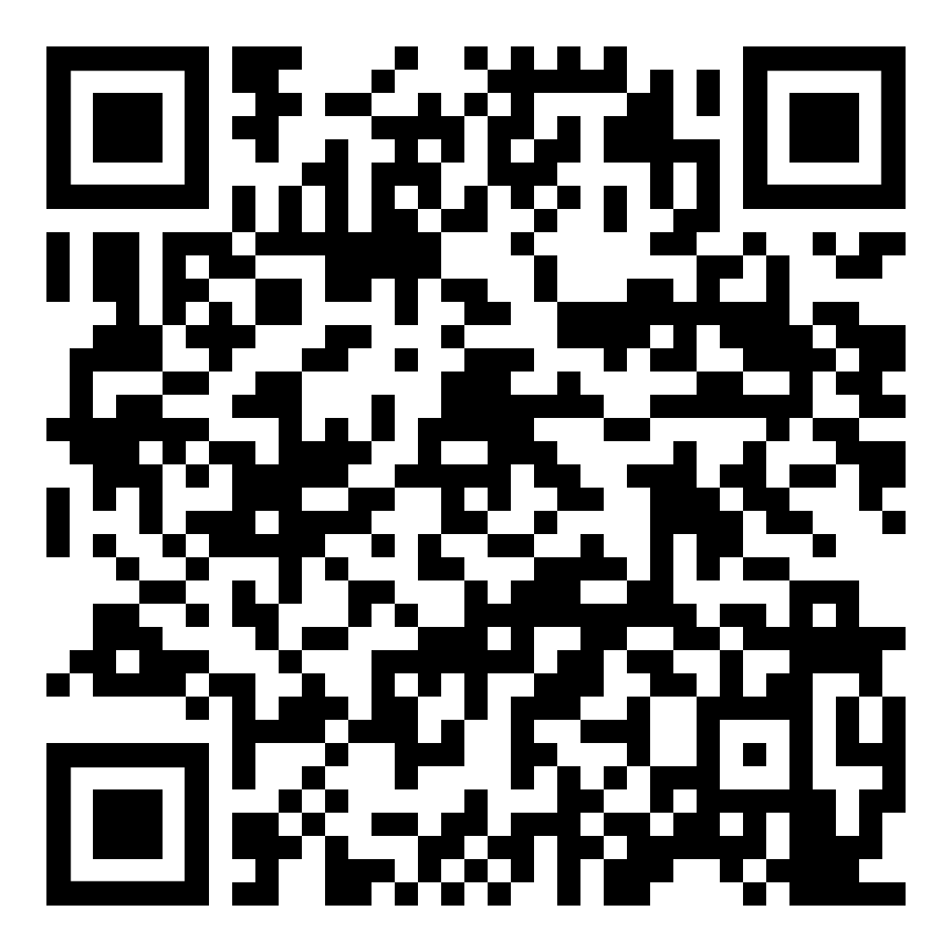
University card
CLICK OR SCAN
Keep your University card on you at all times.
It’s used for:
Identification
Cashless catering
Printing
Book loans and library services
Accessing controlled areas
Notes:
It's important that you carry your University card with you at all times while on University premises. It can be used for identification, and it also gives you access to library facilities, controlled areas, printing and you can set it up to use as payment in some University cafes
(More info about cashless catering (Upay), in case of questions: https://www.ed.ac.uk/catering/upay-cashless-catering-order-ahead )
Further information on your University card can be found at https://www.ed.ac.uk/information-services/help-consultancy/card

Slide 6
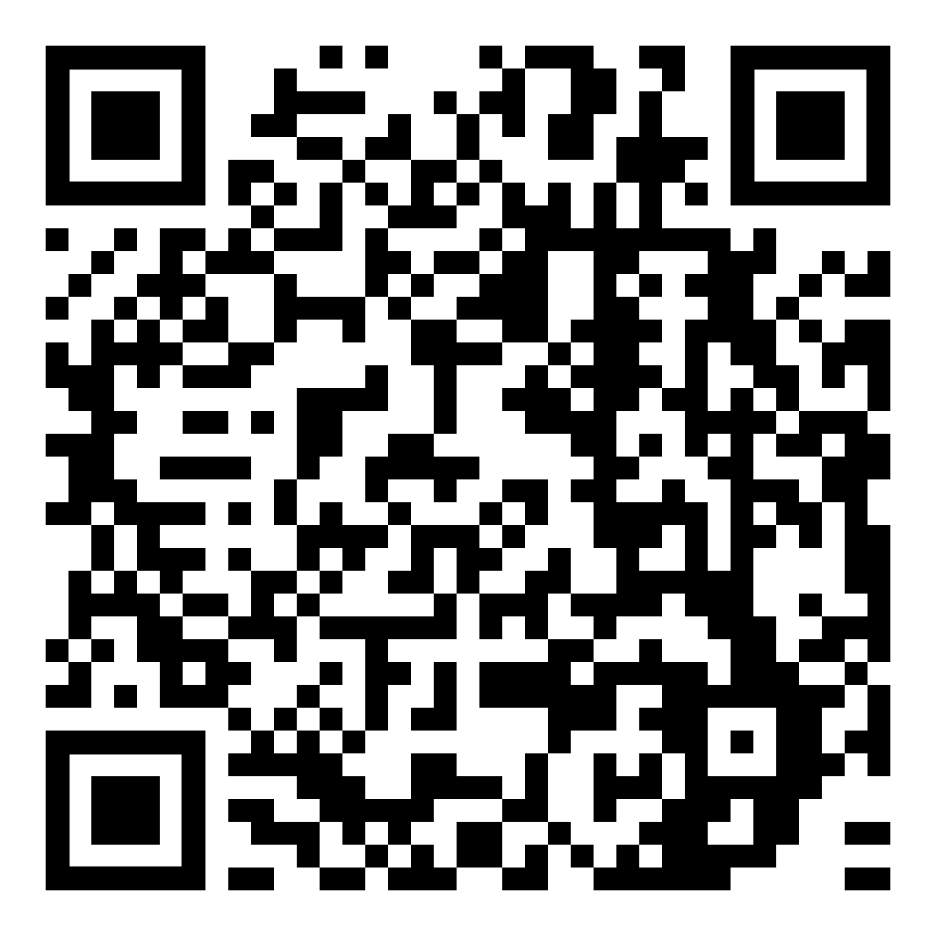
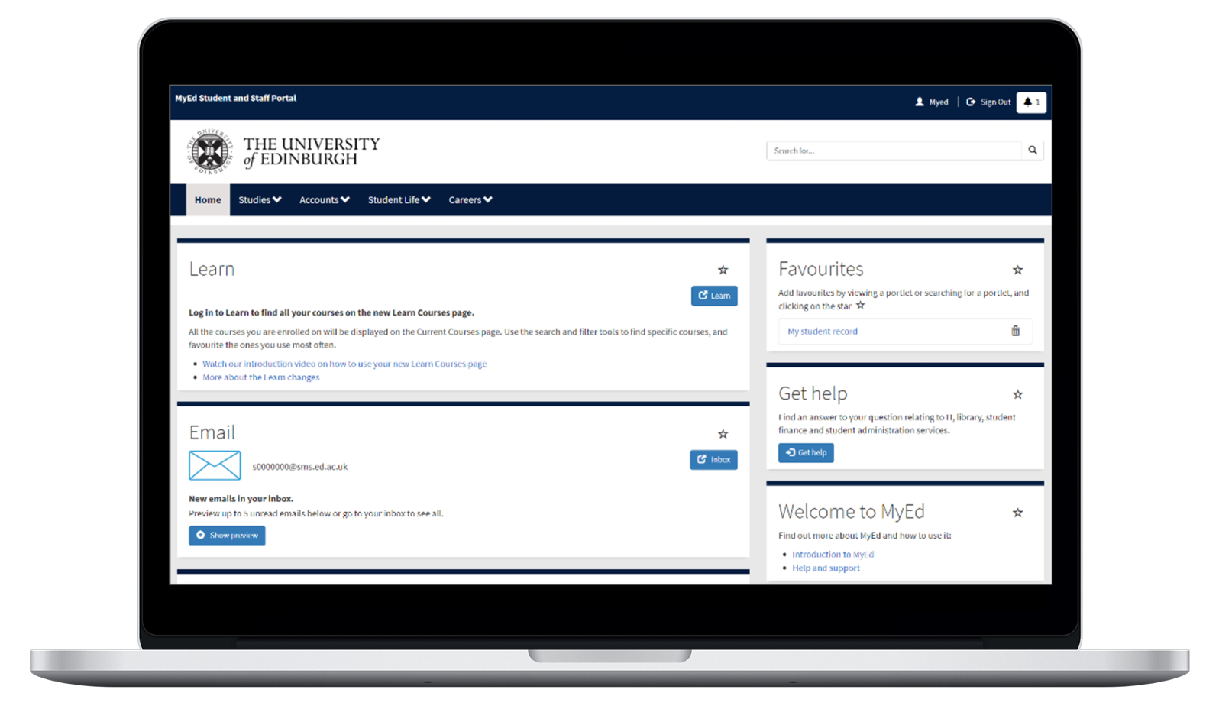
MyEd Portal
CLICK OR SCAN
The University’s main web portal allows
quick and easy access to many systems including:
Virtual Learning Environments
Office 365
Library
Timetables
Accounts
Student support
Notes:
MyEd is the University of Edinburgh's web portal. It provides a centralised access point for web-based services within and beyond the University. You'll have used MyEd during the application process to communicate with the admissions team.
MyEd gives you access to services such as the Learn virtual learning environment, email, library resources, timetables, support information and much more.
MyEd also gives you access to your notifications, alerts about tasks you must complete or other important information.
Further information on MyEd can be found at https://www.ed.ac.uk/information-services/computing/comms-and-collab/myed-portal

Slide 7
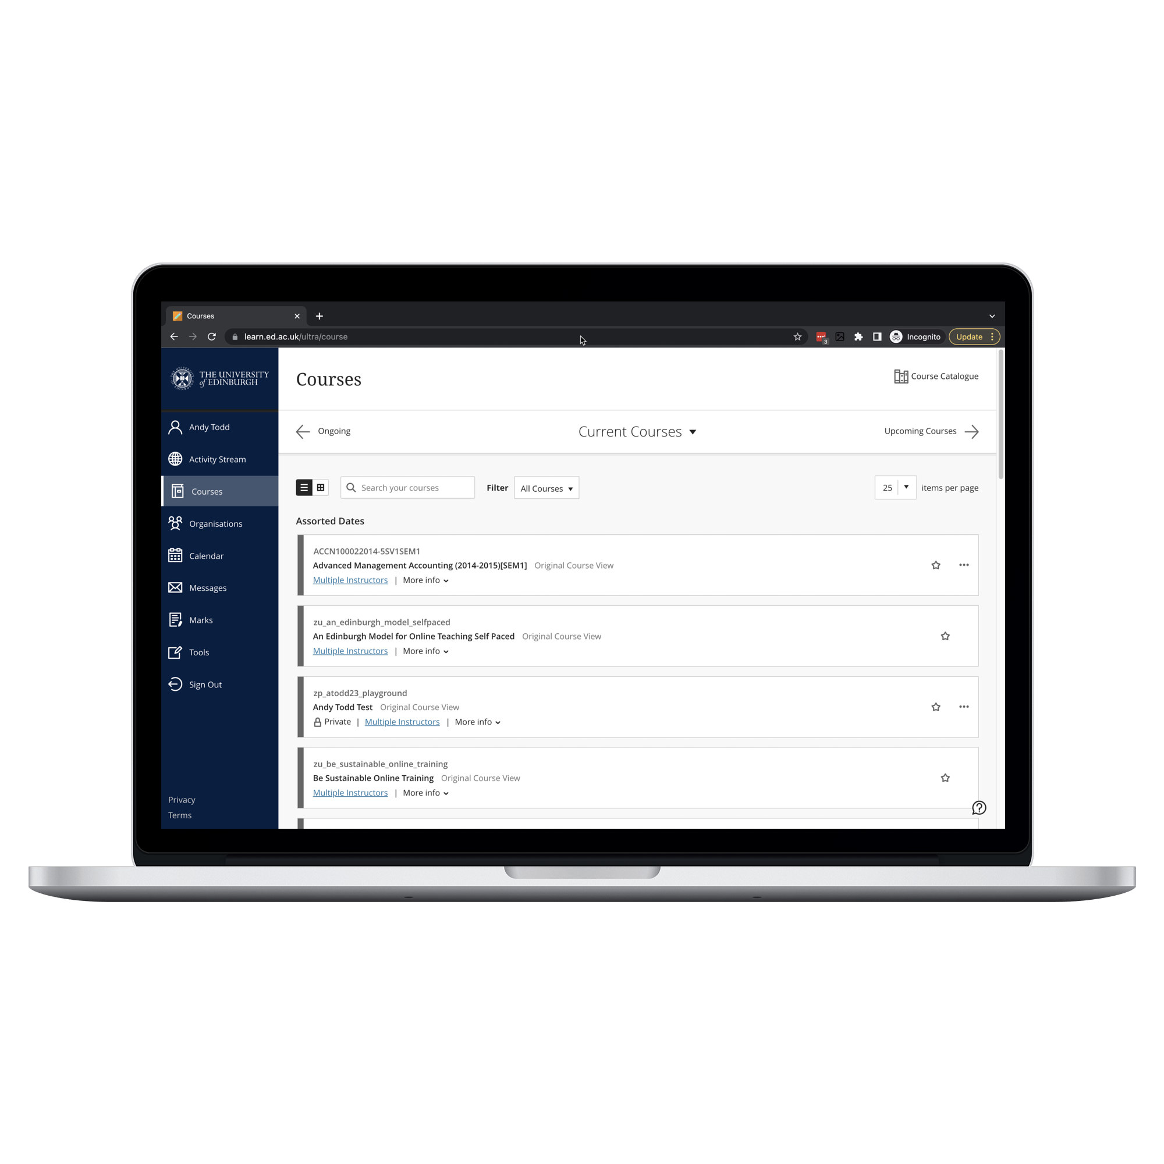
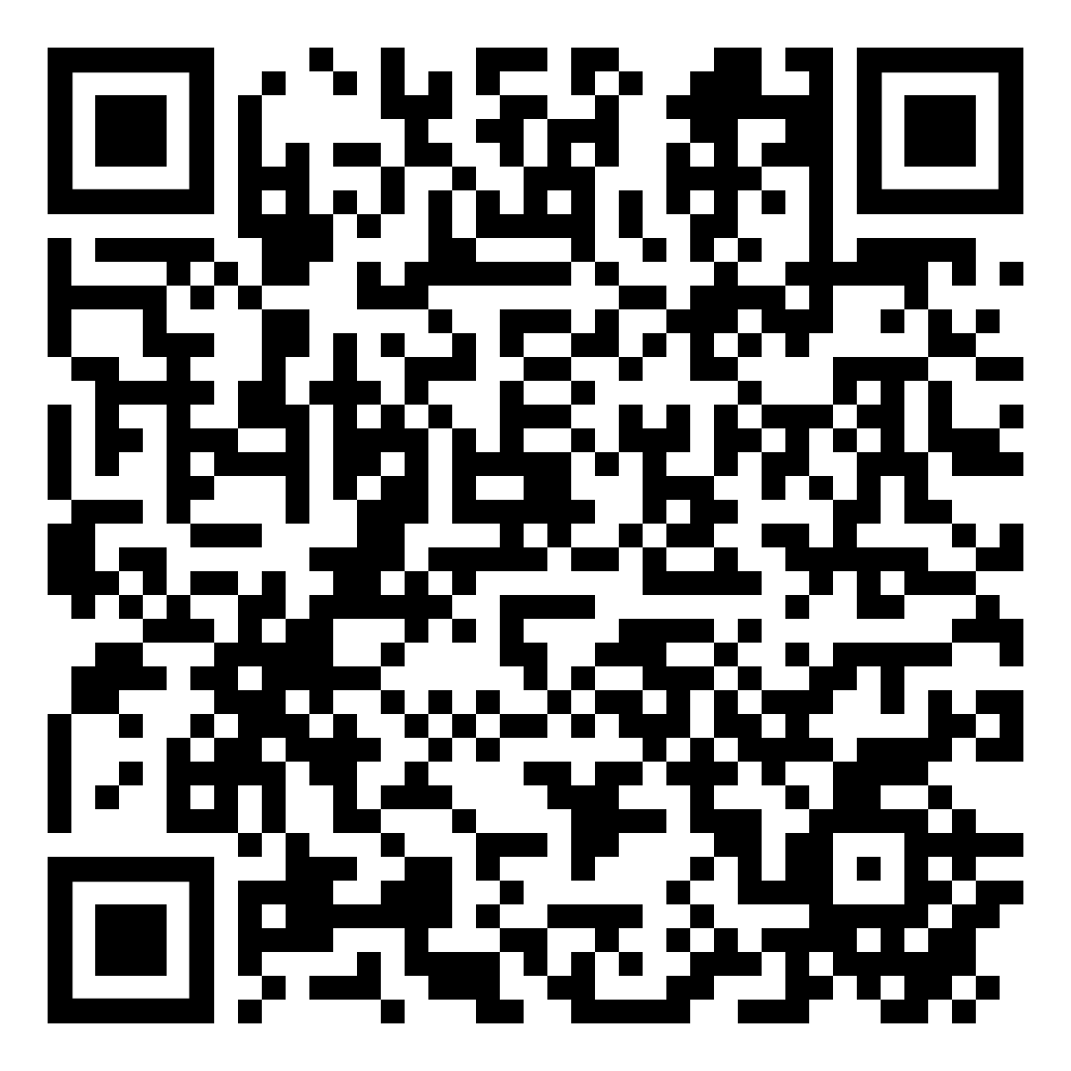
CLICK OR SCAN
Learn
The University’s main Virtual Learning Environment (VLE)
Used to access course materials and course activities such as
  lecture slides
  lecture recordings
  discussion boards
  blogs
  assignments and assessments
Notes:
Learn is the University's virtual learning environment and is used to accompany teaching on most courses. It provides web-based access to course content and tools that may be used for course activities, such as discussion boards and blogs. You can also submit some assignments through Learn.
If your course uses Learn , you will automatically have access to the course within Learn. Your tutor will explain how they want you to use it for your particular course.
Students can either access Learn directly, or via their MyEd homepage.
Before you became a student at Edinburgh you may have had guest access to Learn for online pre-arrival induction courses or as a promotional tool. However, you can't access enrolled courses using guest access.
Further information on Learn can be found at https://www.ed.ac.uk/information-services/learning-technology/learning-technology-training/learn-ultra-training

Slide 8
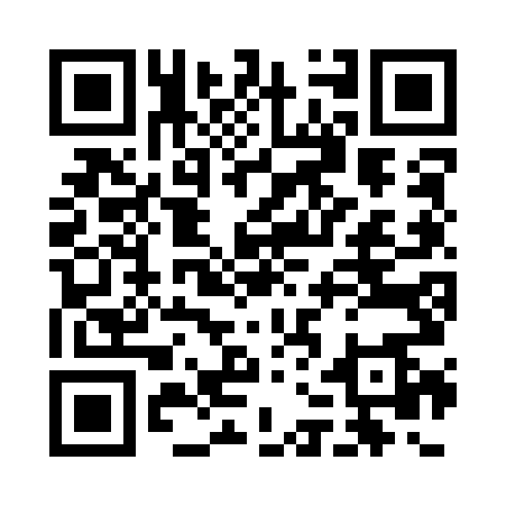
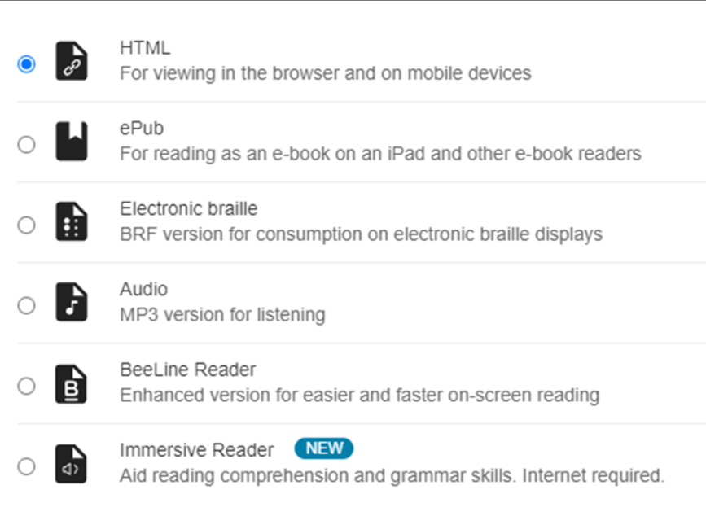
CLICK OR SCAN
Anthology Ally
Ally is a new tool embedded in your Learn Ultra courses that provides accessibility assistance
With the click of a button, you can easily choose an alternative format in which to access your course content
EPub.
Electronic braille.
Audio.
BeeLine Reader.
Immersive Reader.
Notes:
Ally is new for 2023/24. Your instructors are still learning about Ally. The availability of additional formats and their quality depends on the accessibility of the original file. If you can not access the file format you require, please speak to you course instructor. For more information on Ally, visit https://edin.ac/ally.

Slide 9
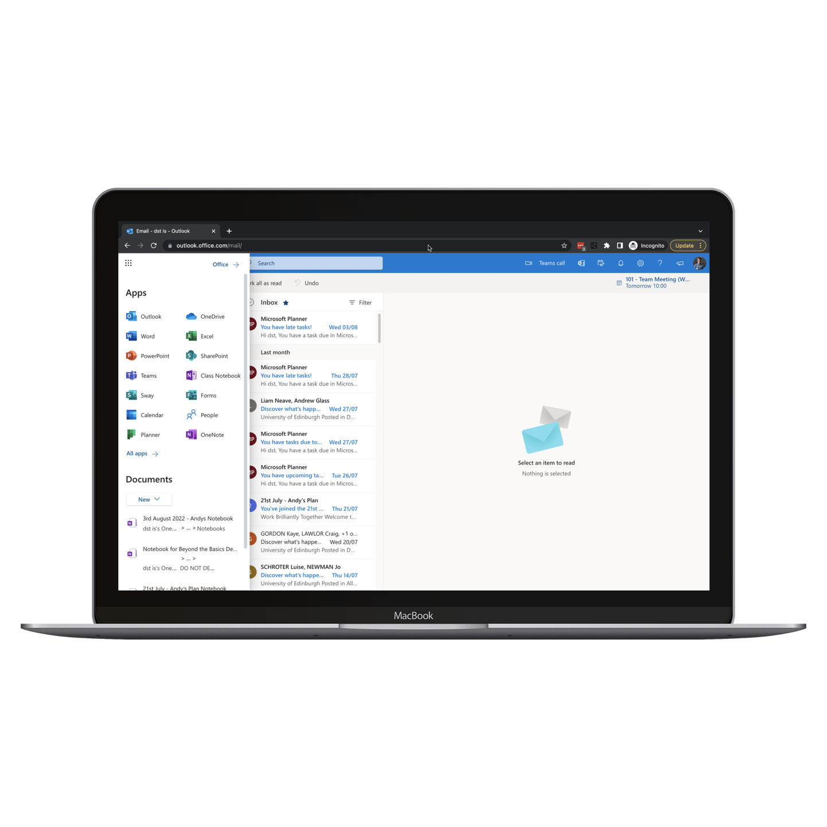
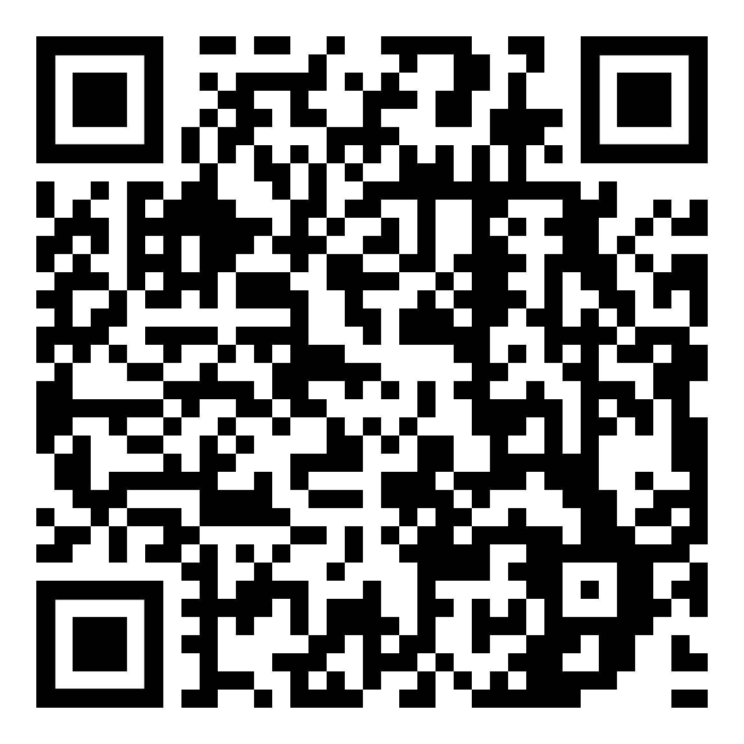






CLICK OR SCAN
Office 365
As a student, you have an Office 365 account.
Login using your full University email address
and password.
Your account gives you access to a range of web apps including:
Notes:
As a University student, you have a Microsoft Office 365 account. This provides a web-based version of Microsoft Office, giving you anywhere access to email and calendar, University staff and student directories, plus cloud-based document access and sharing using OneDrive. It also provides document creation and editing with web apps including Word, Excel and OneNote.
Your login password is the same as your University login, but you need to add “@ed.ac.uk” after your University username.
When you login to Office 365, you're first taken to your Outlook email, this should be checked regularly as it’s where official University communications will be sent.
However Office 365 is a lot more than just email - If you click on the 9 dot “App launcher” button at the top right of the screen you can see the other apps that are available for you to use, some of which are highlighted on this slide. The apps shown on screen are: Outlook on the web, Word, Planner, Excel, OneNote and OneDrive. The Digital Skills and Training team offer a range of training courses teaching you how to use these applications. They are bookable via the event booking channel.
Further information on Office 365 can be found at https://www.ed.ac.uk/information-services/computing/comms-and-collab/office365

Slide 10
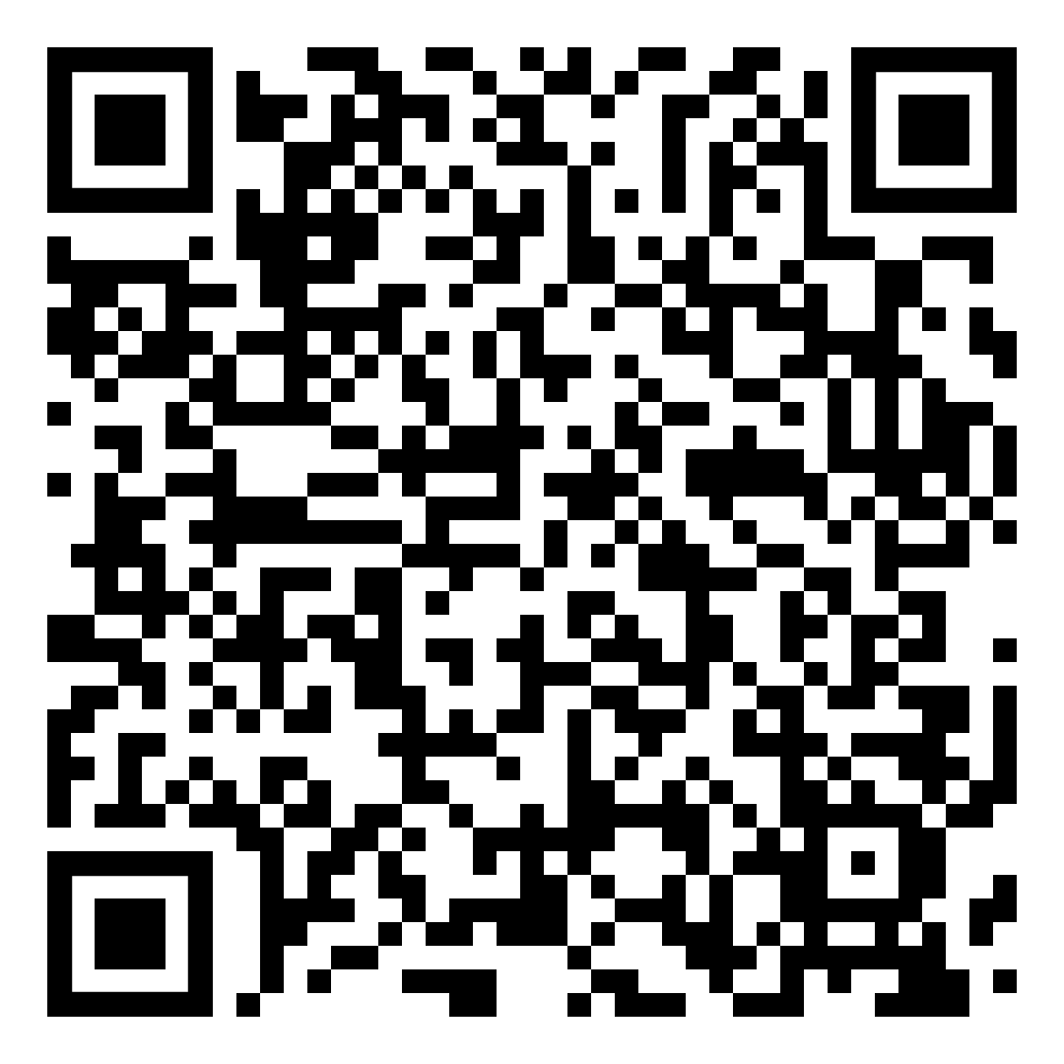
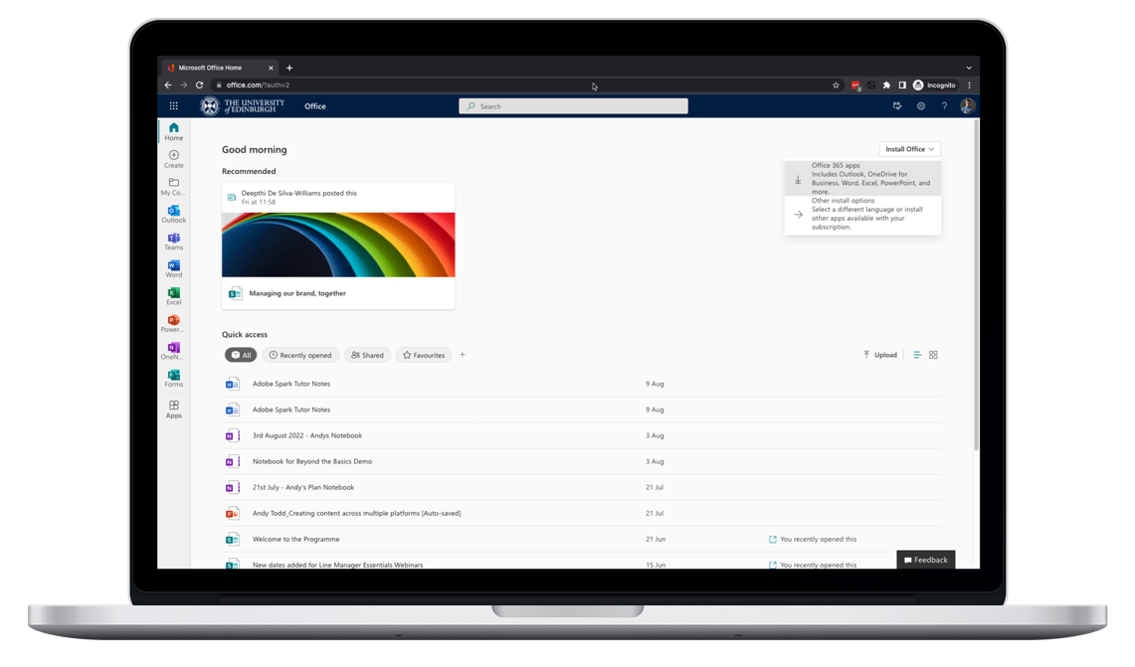
Download
Microsoft Office
CLICK OR SCAN
You can download the full desktop version of Microsoft Office
for free via your University Office 365 account.
Notes:
You can also download and install MS Office Suite on up to 5 devices, allowing you to access Word, Excel, PP and more offline – so NEVER pay for it!
Further information on downloading and installing MS Office can be found at https://www.ed.ac.uk/information-services/computing/comms-and-collab/office365/latest-office

Slide 11
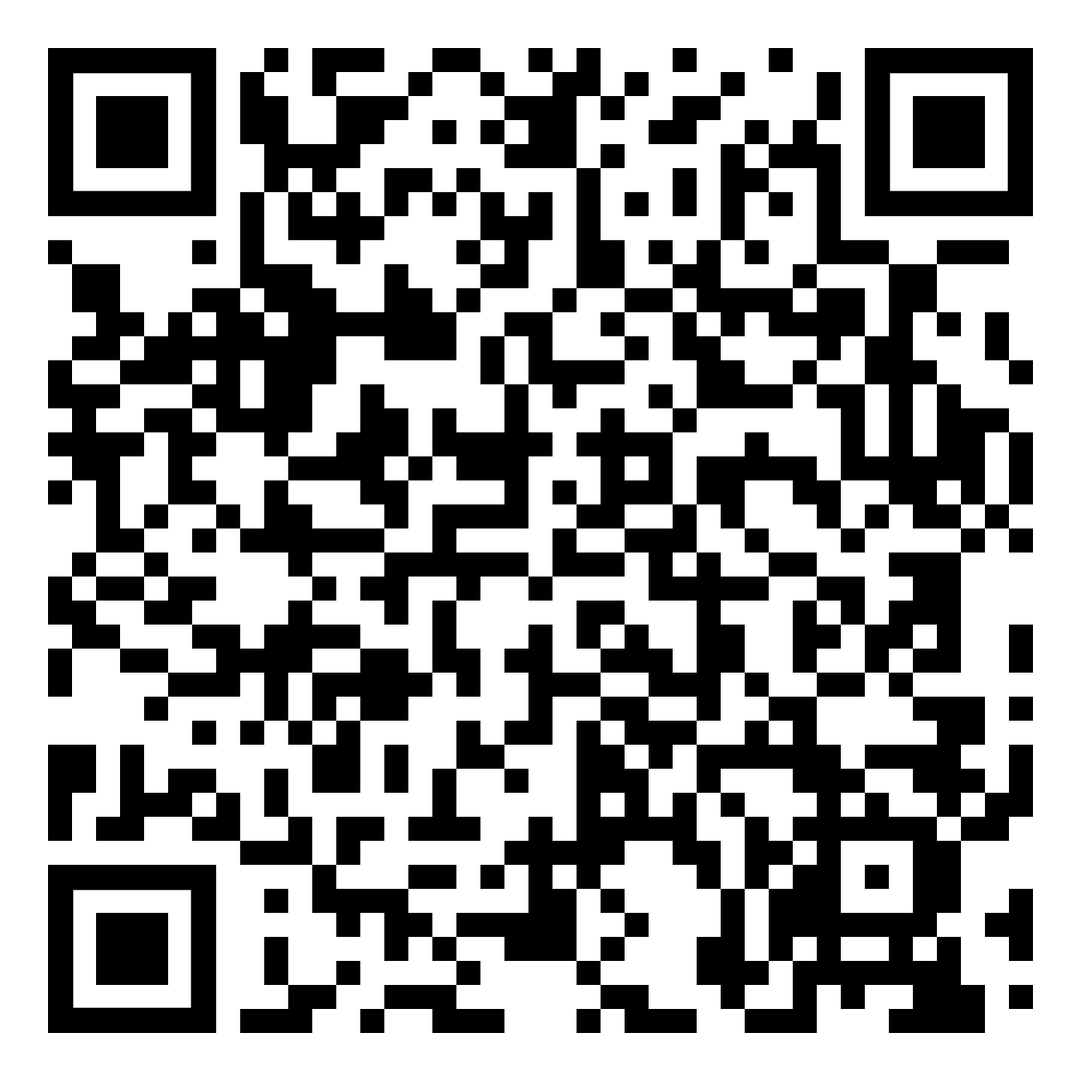
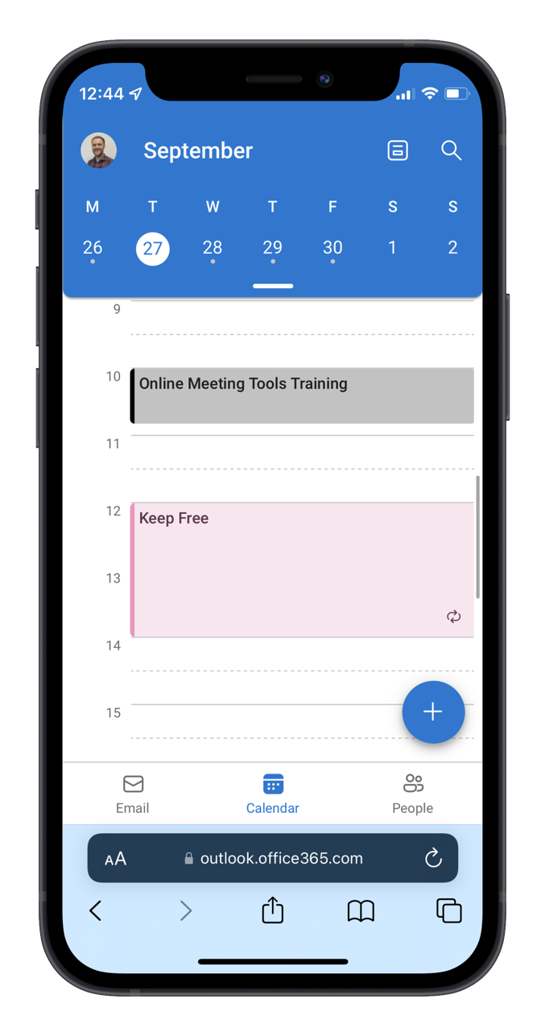
CLICK OR SCAN
Timetable on My Phone
Your timetable information can be accessed via your University Office 365 calendar.
You can also add your calendar to your phone so you can access your timetable wherever you are.
Notes:
Your MyTimetable information can be easily accessed on your Office 365 calendar that is linked to your university email address. Once you are logged into your Office365 account just click on the calendar icon in app toolbar. By adding your calendar to your phone or other device you can access your personalised MyTimetable information wherever you are.
Your Office 365 calendar starts showing your core teaching activities a week or 2 before the start of teaching.
Please note that as updates can take time to appear in your Office 365 calendar and will be inputted in scheduled phases, therefore you may only be able to see a week or 2 in advance at the start of Semester and it could take up until the end of December for the full academic year to show.
Further information on Timetabling with Office 365 can be found at https://www.ed.ac.uk/information-services/computing/comms-and-collab/office365/timetable-on-my-phone

Slide 12

02
Computing
and printing
services

Slide 13
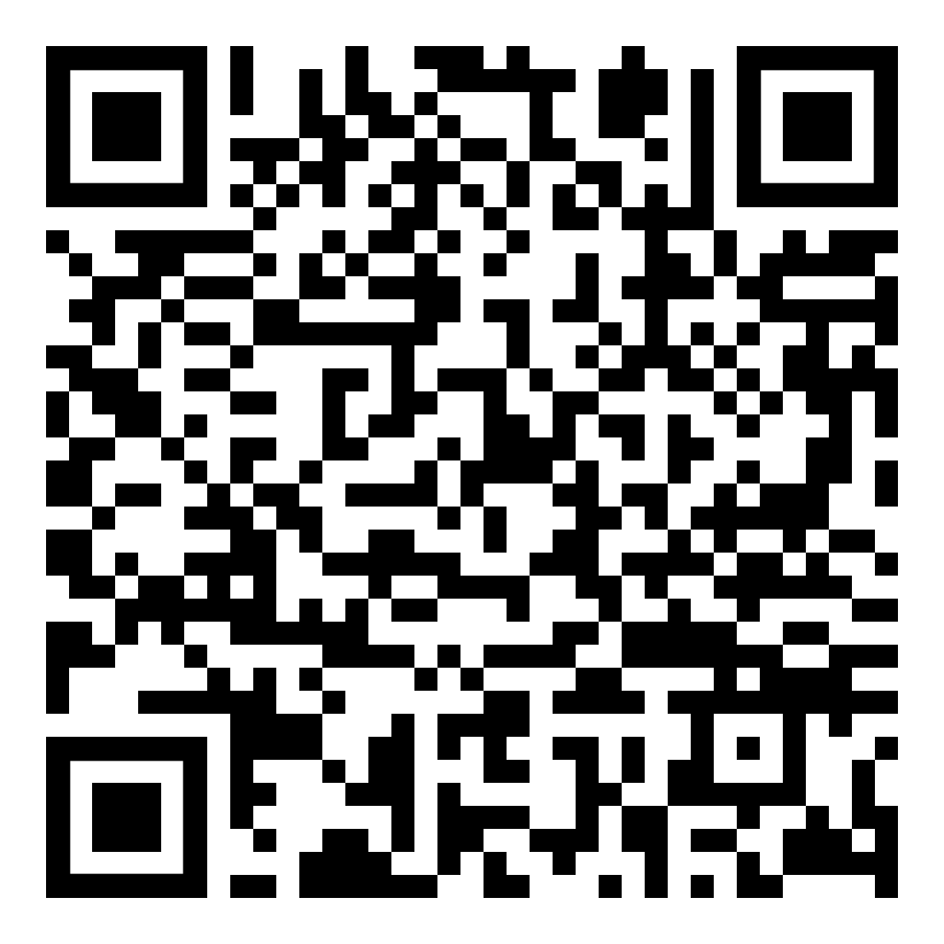
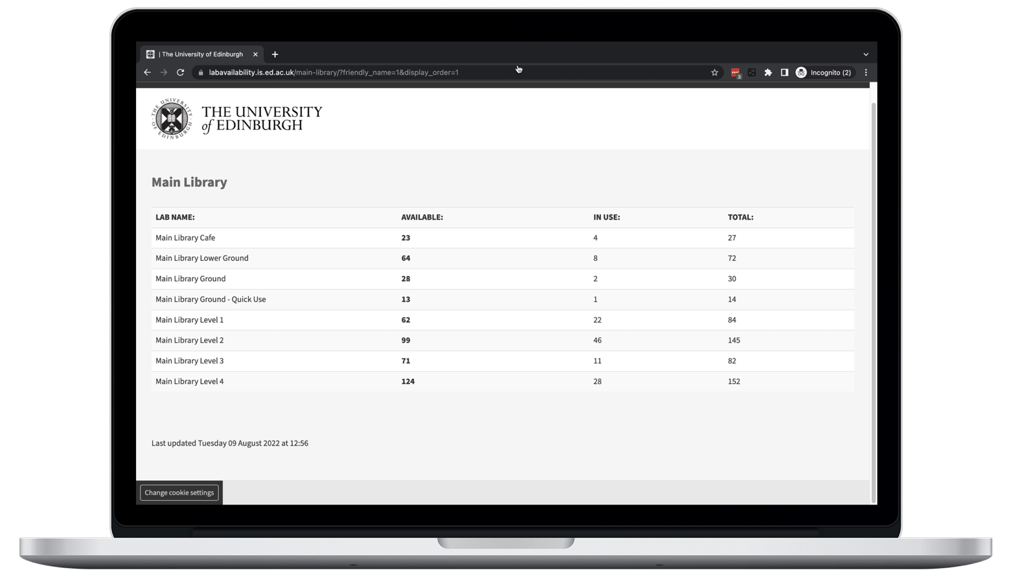
Study space with computers
CLICK OR SCAN
LOCATIONS
Located in libraries, cafes
and some halls of residence.
LOGGING IN
Read computing regulations and log in
using your username and password.
AVAILABILITY
Check availability on study space with computers webpage or building information screens.
Notes:
As a student, you can use the use computers within various areas across the University with your University username and password.
There are computers for you to use in the central area, libraries and cafes, Kings Buildings campus, Holyrood campus and some halls of residence. You can find a full list of locations on the web page.
You need to have activated your Office 365 email account before you can log-in to the open access computers.
Further information on open access computing can be found at https://www.ed.ac.uk/information-services/students/study-space/computers-for-study

Slide 14
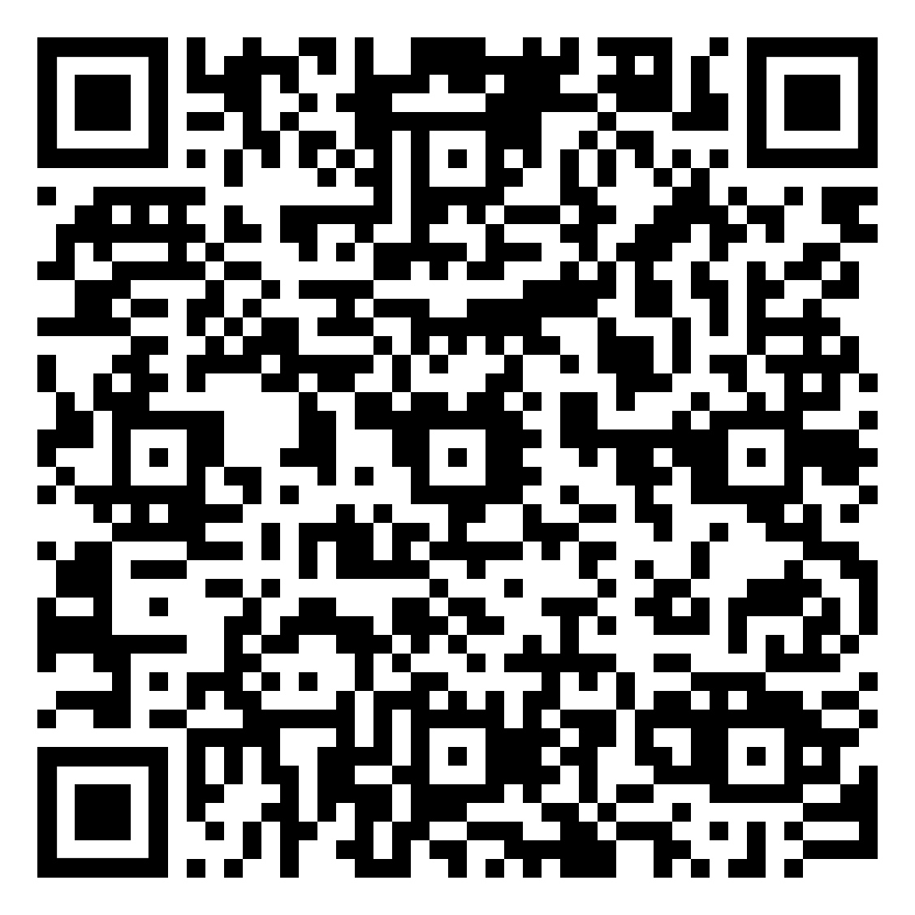
CLICK OR SCAN
Saving your files
You can back up your University work safely and securely to:
Your personal University drive (M drive) with
2GB storage and daily back-ups.
Your OneDrive cloud storage account with
1TB storage - accessible anywhere, anytime,
and with any device.
Notes:
First, saving files.
It is important to make sure your University work is saved securely and you should make back-ups of important files.
The University provides 2 places where you can store files.
Every student is assigned space on a University server. This is known as your M: drive. When you're logged into a University computer, the M drive will be the Documents folder and you'll be able to access files you've saved there.
There is also the OneDrive cloud-based storage on Office 365
It's worth noting that the space on your M drive is a lot less than the space on Office 365.
Further information on document management as a student can be found at: https://uoe.sharepoint.com/sites/sharepoint-solutions-service/SitePages/Personal-Document-Management-at-University.aspx

Slide 15
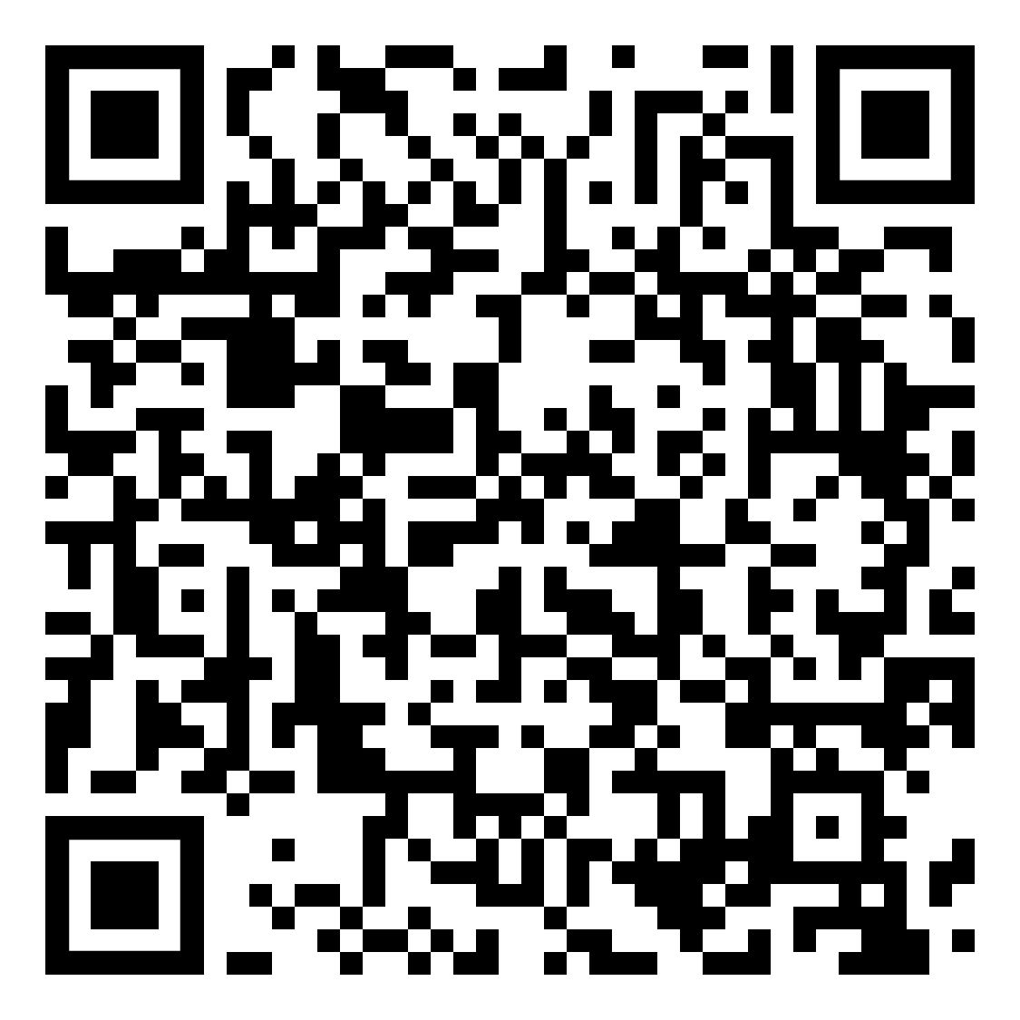
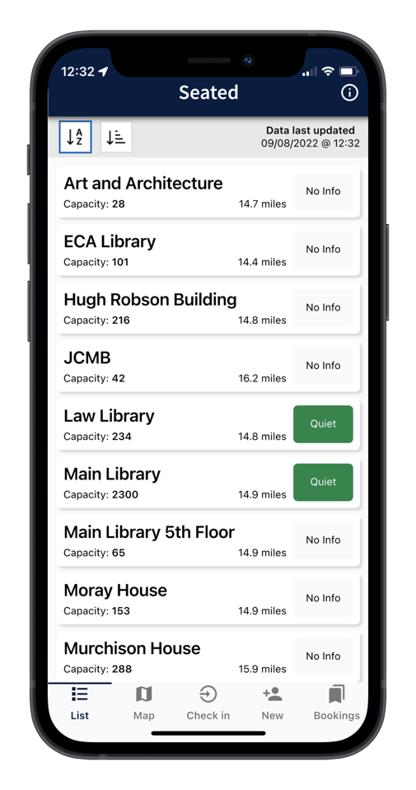
CLICK OR SCAN
SeatEd app
You can download the University’s
SeatEd app to view study space locations,
check live occupancy details and reserve
a study space.
Notes:
You can pre-book study spaces using the SeatEd app.
Install the app before you arrive at a study space. It will enable you to check-in and check-out of study spaces by scanning desk QR codes. Please do not attempt to use your smartphone's default camera app, as this will not be able to scan desk QR codes.
The official name of the SeatEd app is: SeatEd@UoE
You can find the app in Apple's App Store and the Google Play Store.
Further information on the SeatEd app can be found at https://www.ed.ac.uk/information-services/students/study-space/study-spaces-app-user-guide

Slide 16
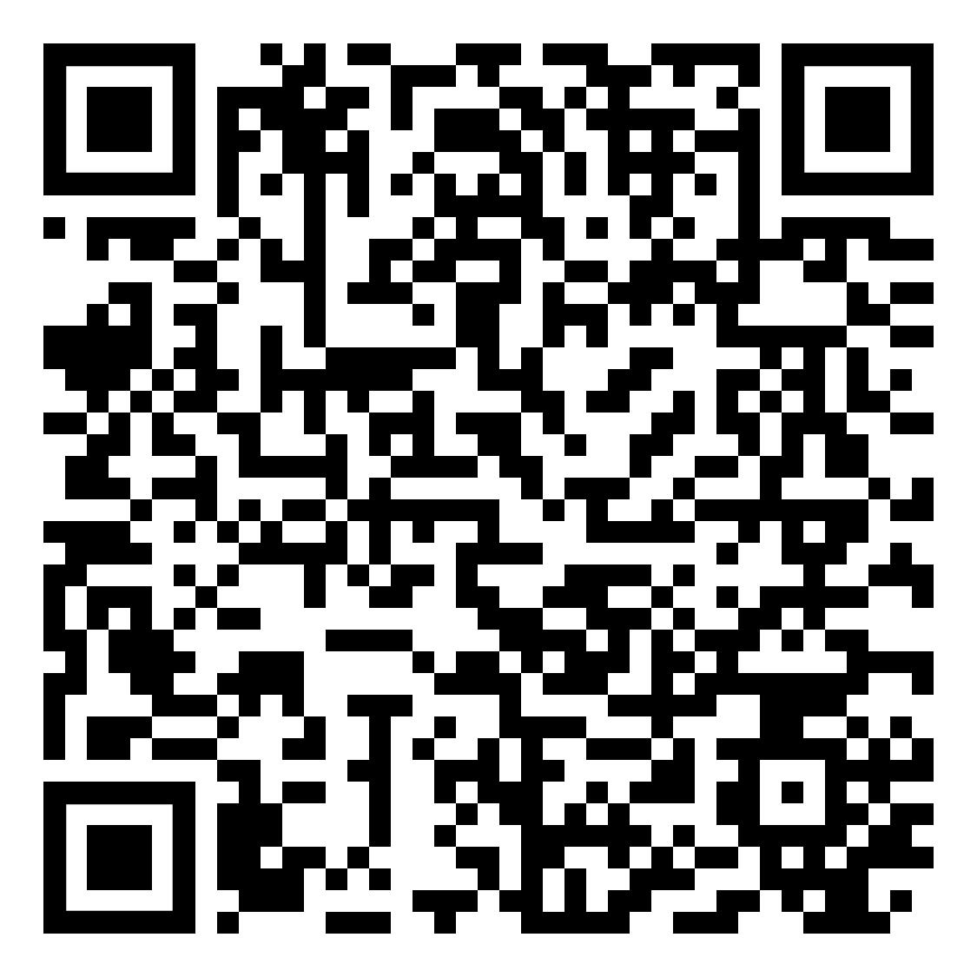
CLICK OR SCAN
Accessible PCs
Accessible PCs with assistive software
and hardware can be found in open
access areas across the University.
Accessible study rooms can be booked
via the University’s Disability and
Learning Support Service.
These rooms are located at the
Main Library, Murray Library and
Murchison House (both King’s Buildings)
Notes:
Accessible PCs are available at several locations around the University and provide assistive software and hardware designed to help disabled people. Information about the equipment available and a Quick Start Guide can be found on the webpage on the slide.
There are also bookable accessible study rooms in the Main Library and on the King's Buildings campus. These rooms are only for disabled students registered with the Disability and Learning Support Service (formerly called the Student Disability Service).
Further information on accessible PCs can be found at https://www.ed.ac.uk/information-services/help-consultancy/accessibility/assistive-technology/pcs-campus

Slide 17
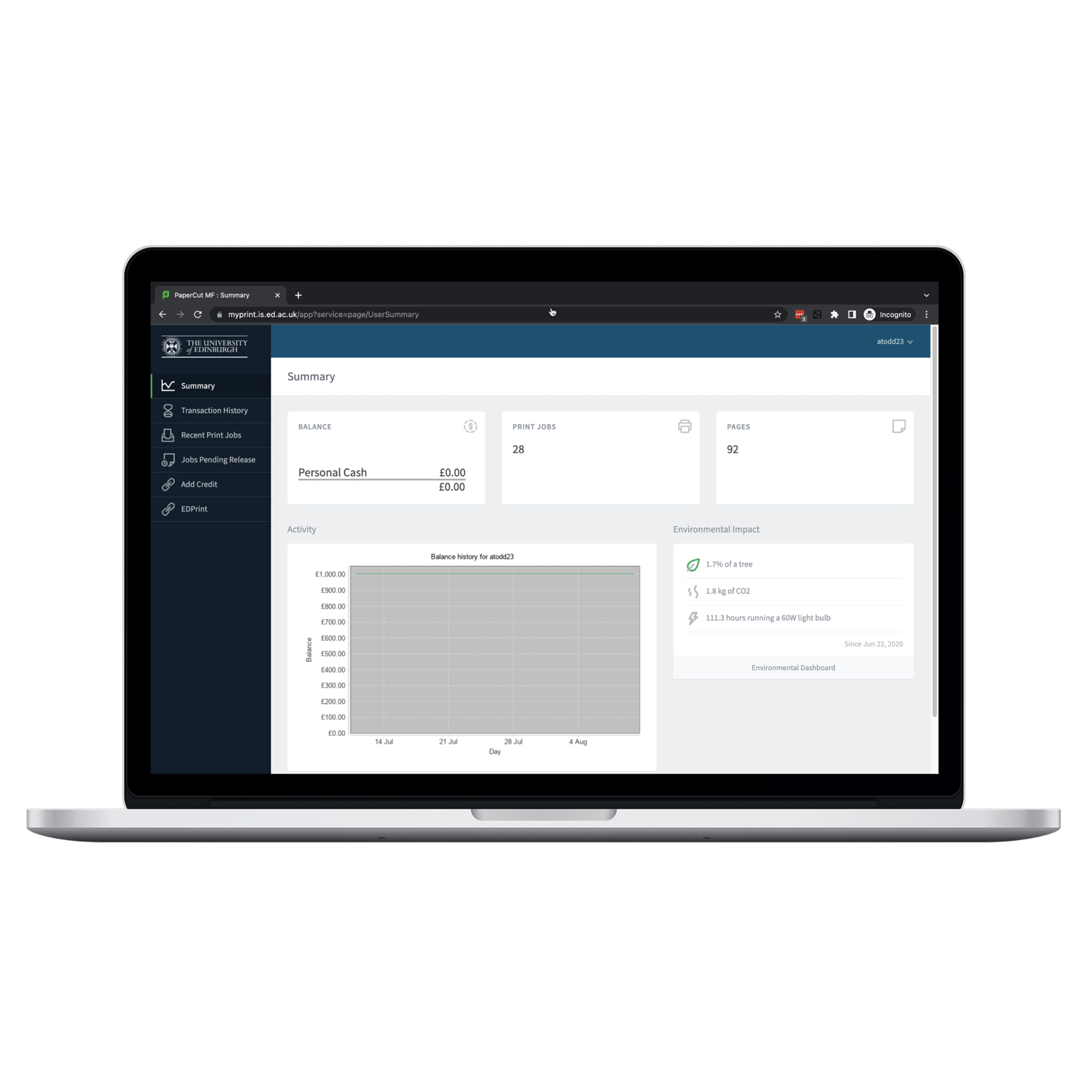
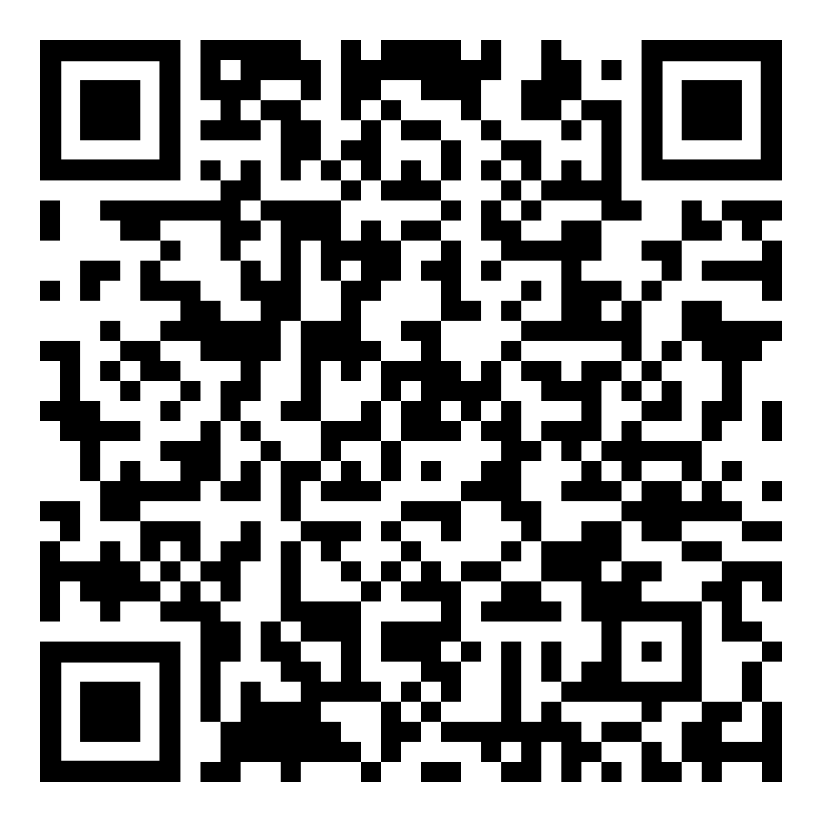
CLICK OR SCAN
Printing
Cloud printing allows you to print to any University printer from any device across campus.
Printing costs vary depending on what you are printing. Print jobs and credit can be managed through myPrint.
Notes:
EdPrint is the university's printing, copying and scanning service. You can print from the open access computing labs, but please be aware that printing incurs a small charge – prices are on the website. You can check your printing account balance and add more credit at myPrint link on the website. After you send a print job to the printer, you need to go and swipe your University card to release it. You're not charged until it's actually printed.
(Printing & copy costs webpage in case of questions: https://www.ed.ac.uk/information-services/computing/desktop-personal/EdPrint/printing-copying-scanning/cost-print-copy )
Further information on the printing at the University can be found at https://www.ed.ac.uk/information-services/computing/desktop-personal/edprint

Slide 18
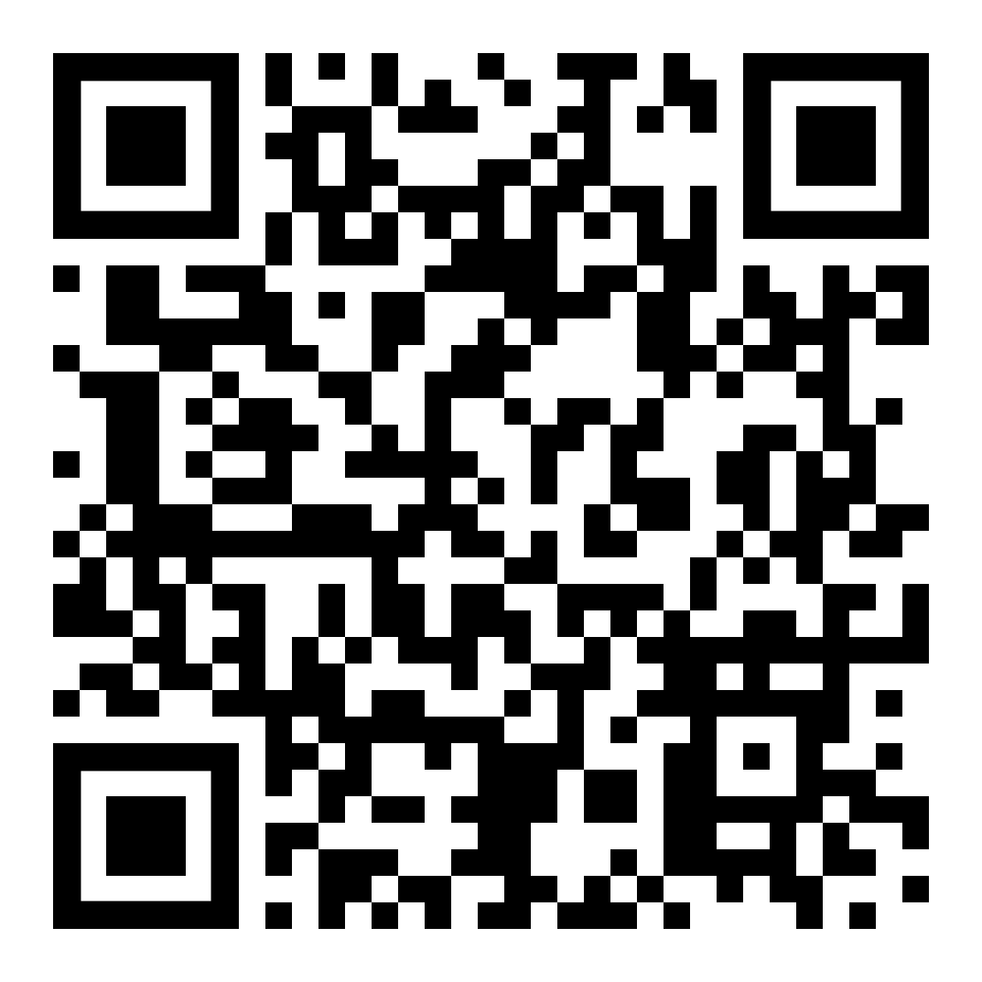





CLICK OR SCAN
Makerspace
uCreate Makerspaces, Multimedia bays and loans allow you to use equipment like 3D printers, access specialist software, and borrow equipment for off-site use.
Notes:
uCreate provides equipment, advice, training and support to help you make (almost) anything!
Makerspaces offer supported self-service use of a wide range of specialist equipment from 3D Printers to VR headsets, with staff on hand to provide training and support.
Multimedia Bays hold high performance computers, specialist software and hardware for multimedia, motion graphics and other creative work.
uCreate loans let you borrow specialist kit for use off site.
All of the tools, technology and support are available to anyone in the University of Edinburgh community (and most of it is free!).
Pop in to the uCreate Makerspace in the Main Library or have a look at the uCreate website for more information.
Further information on the uCreate Makerspace can be found at https://www.ucreatestudio.is.ed.ac.uk/

Slide 19

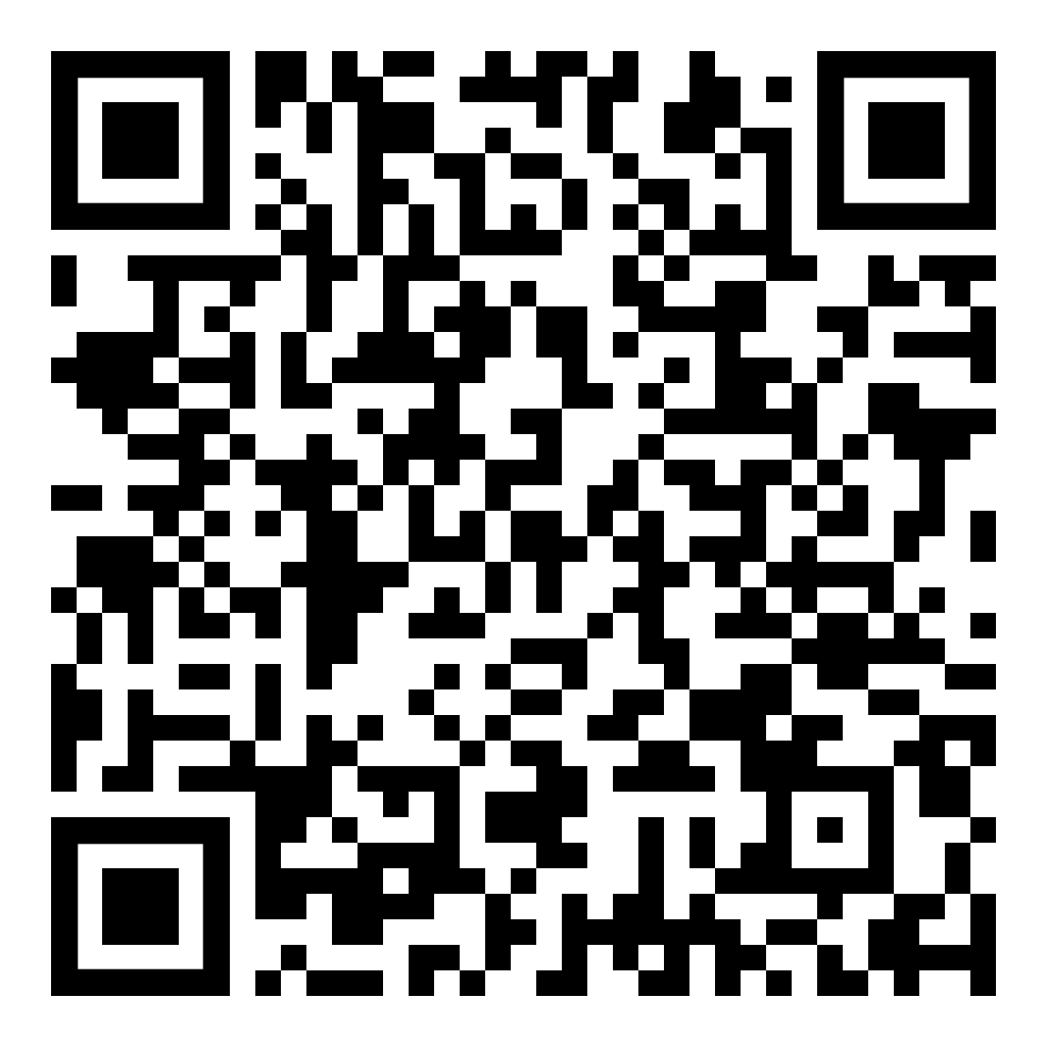



CLICK OR SCAN
Azure Virtual
Desktop
Provides remote access to specialist
software applications not installed
on your device including:
Notes:
Azure Virtual Desktop is a system that allows you to go online to use software that you need for your studies but is not installed on your computer.
Some of the applications you can access include Mathematica 12, Python (coding), EndNote 20, Mendeley (reference management) and Pro Tools (audio editing).
Further information on Azure Virtual Desktop can be found at https://www.ed.ac.uk/information-services/computing/desktop-personal/avd

Slide 20
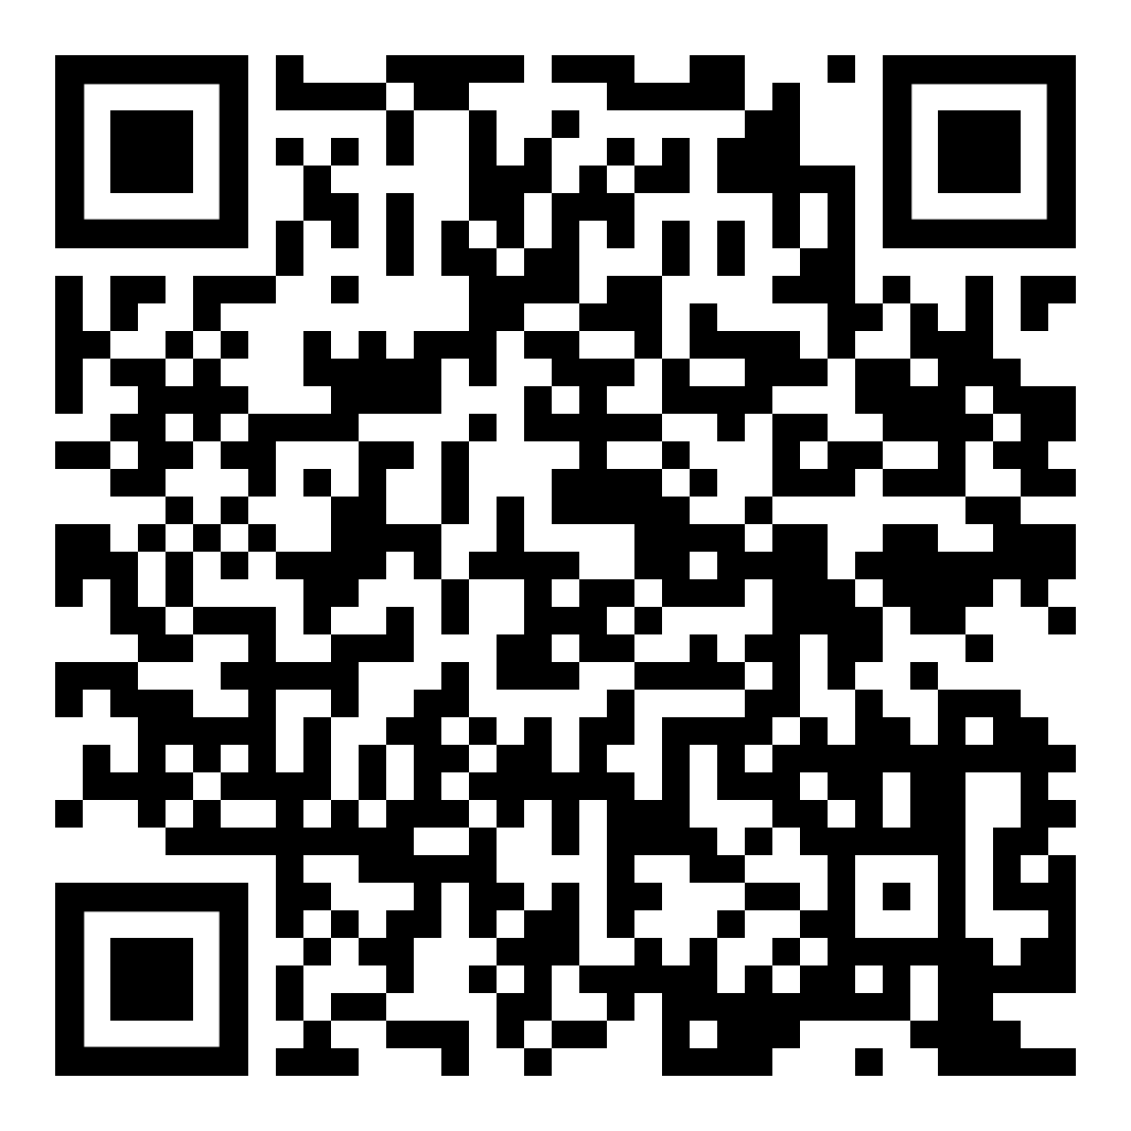

CLICK OR SCAN
Lecture Recording
Media Hopper Replay is the University’s lecture
recording service. If your lectures are recorded,
your lecturer will let you know when recordings
are taking place and how to access them.
Over 400 rooms across campus are set
up to record lectures and seminars.
Notes:
Media Hopper Replay is the University’s official lecture recording service.
Many, but not all, lectures are recorded using Media Hopper Replay. Please check with your lecturer to see if your lecture is recorded. Recorded lectures are accessed through Learn.
(If you’re giving the presentation in a Media Hopper Reply-enabled room, point out the light on the desk and that it is red when recording)
Further information on Media Hopper Replay can be found at https://www.ed.ac.uk/information-services/learning-technology/media-hopper-replay

Slide 21

03
Mobile
computing

Slide 22
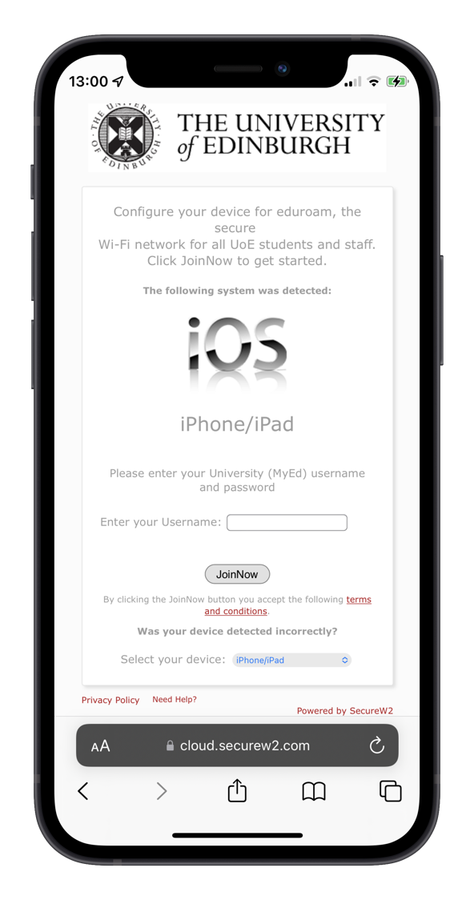
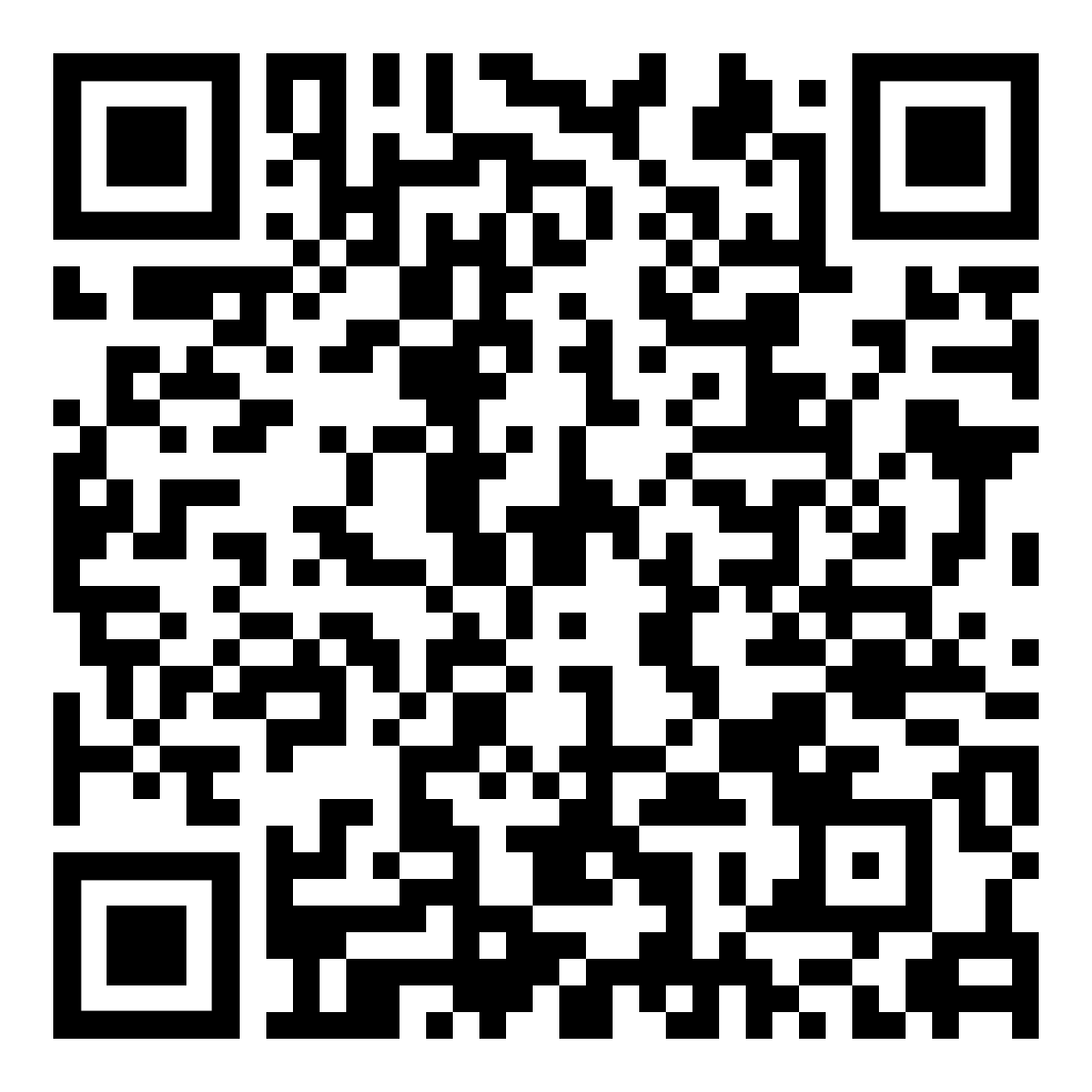

Wi-Fi
CLICK OR SCAN
The University’s secure wireless network is called eduroam. Connect using your University username and password.
You can connect manually from your device’s Wi-Fi settings or automatically using the University’s eduroam connection app.
eduroam can also be used when
visiting some other institutions.
Notes:
Our eduroam wireless network is available throughout the University.
Once your device is connected it will also give you access to the wireless network at other institutions across the UK, and even the world, that use the eduroam service.
The easiest way to configure your device for Wi-Fi is to use the eduroam connection app. This is downloaded from the link on the slide. It can be run before or after you arrive on campus. The app will detect your operating system and configure your device to connect to eduroam on campus.
If you have any problems, contact EdHelp (more details about this later in the presentation).
For further information on connecting to the University’s wireless network visit https://www.ed.ac.uk/information-services/computing/desktop-personal/Wi-Fi-networking

Slide 23
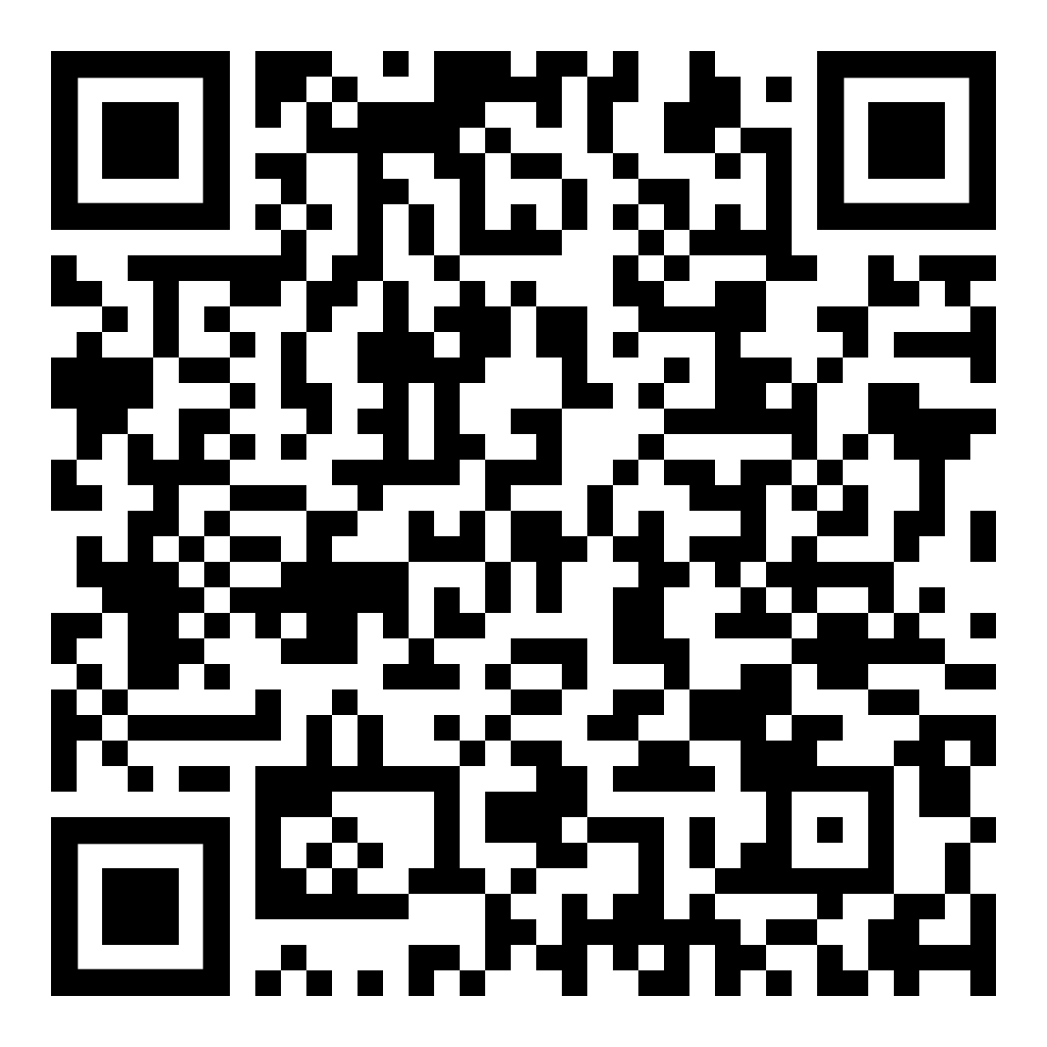
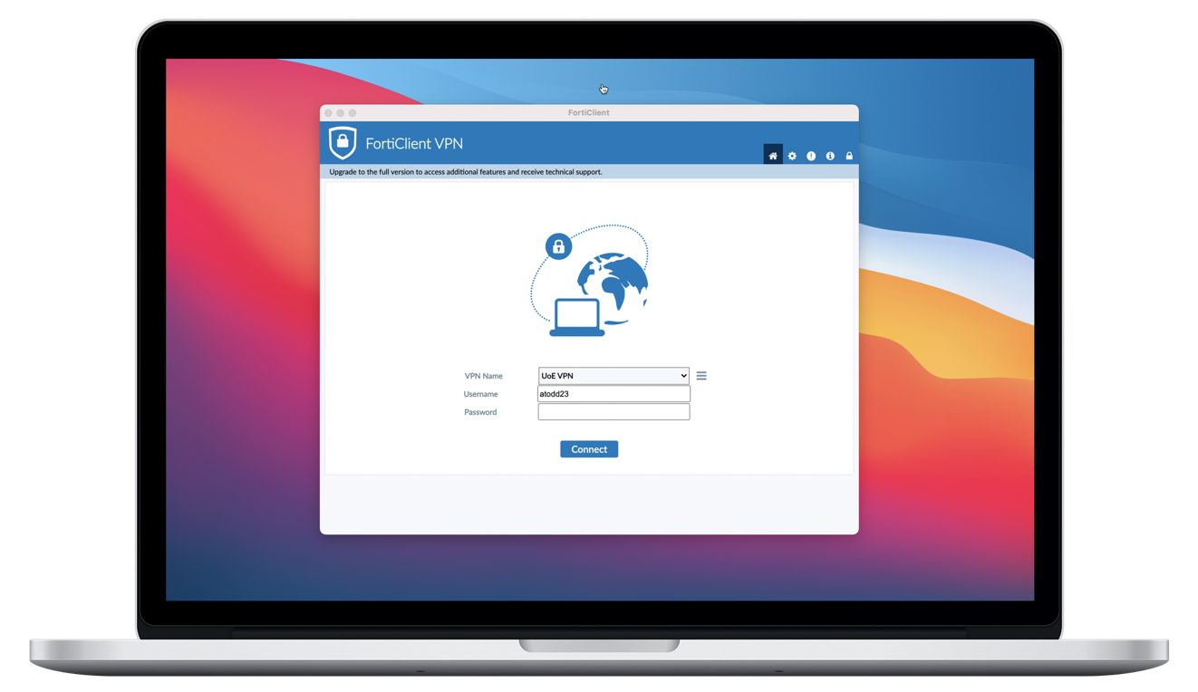
CLICK OR SCAN
Virtual Private Network (VPN)
Creates a secure off-campus connection between your device and the University network.
REGISTRATION
PROTECTION
ACCESS
Registration is required
to use the VPN service.
Hides passwords and
provides additional security.
Allows access to some restricted services.
Notes:
The University’s Virtual Private Network service provides a method for securing communication between your computer at home or other non-work location, and the University network. You may wish to connect via VPN to access resources that are normally inaccessible from outside of the University's network, such as some library services.
Staff and students wishing to use the VPN service need to register at the webpage on the slide. Please note that your VPN password has to be different to your main University login password.
(List of which services do and do not require VPN https://www.ed.ac.uk/information-services/computing/desktop-personal/off-site-working/getting-set-up/services-vpn-rdp )
Further information on using the University’s VPN service can be found at https://www.ed.ac.uk/information-services/computing/desktop-personal/vpn

Slide 24
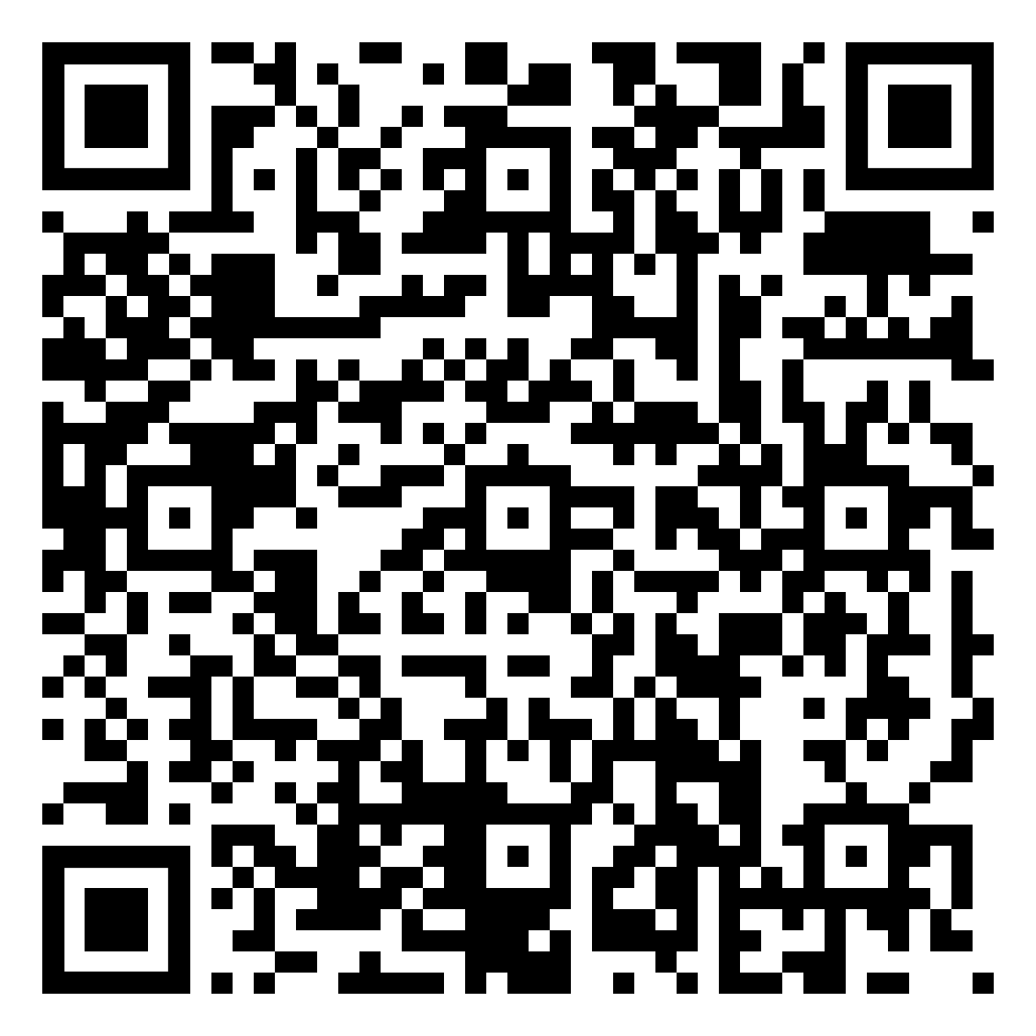


Laptop Loans
CLICK OR SCAN
Laptops can be borrowed from EdHelp service desks in all libraries. Self issue laptops are available in the Main Library and Noreen & Kenneth Murray Library (King’s Buildings).
7-28 day
Loans.
Extended loans
for students
in hardship.
Mi-Fi Units
available for
Students
in hardship.
Notes:
Students can borrow laptops from the EdHelp services desks in the Main Library and nine Information Services site libraries; there is a self-issue facility for laptops in the Main Library and the Murray Library. There's no reservation system. The standard loan period is seven days, which you can renew three times.
Longer term loans are also available based on need.
MiFi units (mobile wireless hotspots) are also available for students in hardship.
Further information on laptop loans can be found at https://www.ed.ac.uk/information-services/library-museum-gallery/using-library/borrowing-a-book/borrowing-laptops

Slide 25

04
Library
services

Slide 26
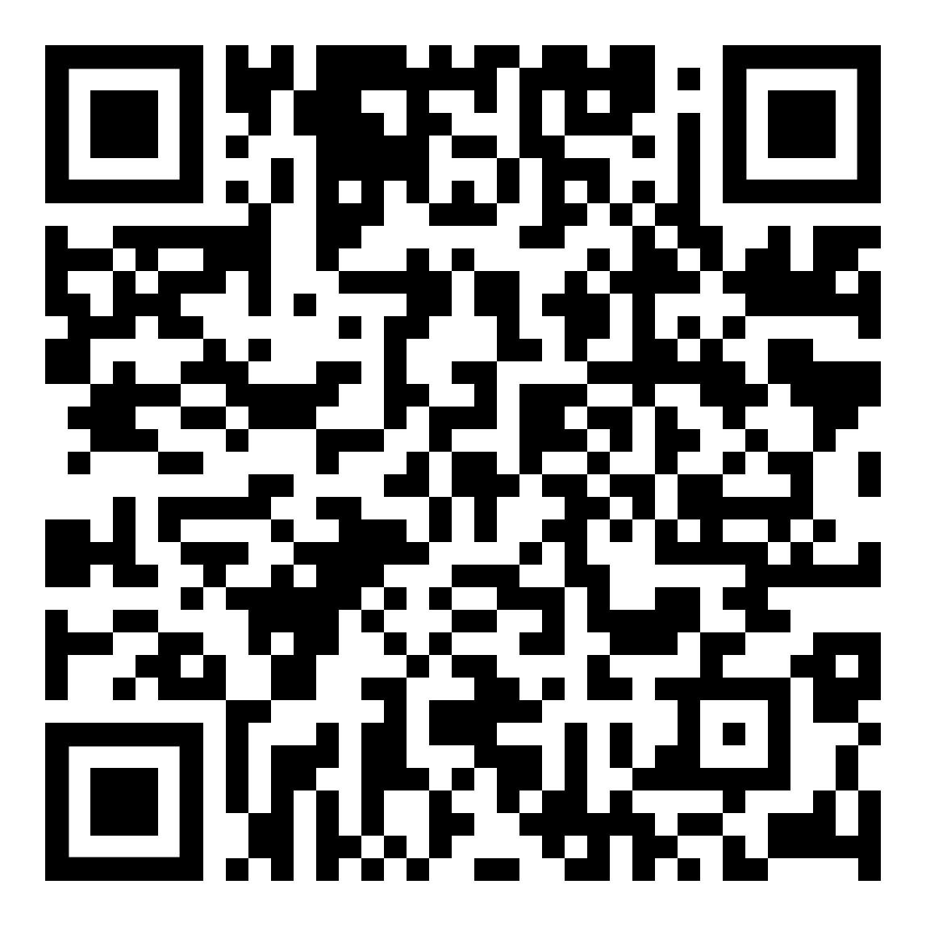
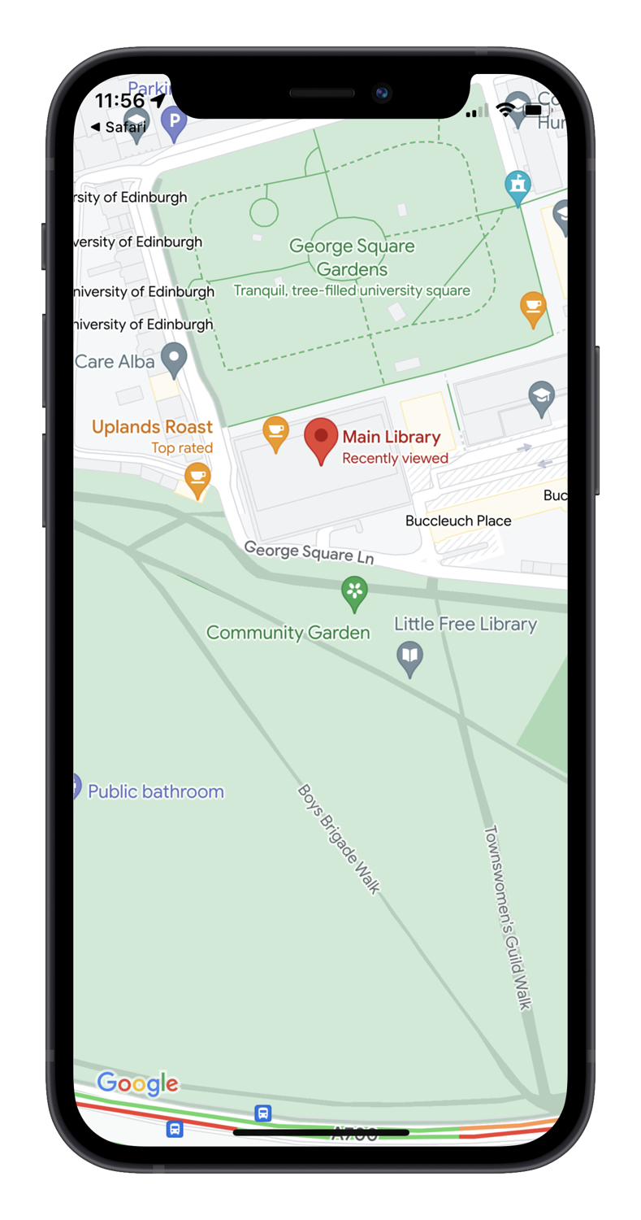
Library basics
CLICK OR SCAN
LOCATIONS
You can get into, and borrow from, all 11 centrally-run libraries using your student card.
FACILITIES
BOOK
LOANS
OPEN-ACCESS COMPUTING
PRINTING &
SCANNING
STUDY SPACES
[11 centrally because there are a small no. of school run libraries]
Book loans
Open access computers
Printing, scanning and multimedia
Study spaces (group, formal and informal)
Notes:
This section will introduce you to how the library can help you get started with your studies. ​
​
There are 11 centrally-managed Library sites across the University. Some are focused on a subject area but you are welcome to use any of the libraries. You will need your University card to enter the libraries and to borrow items.
As well as holding the Library's book collections the libraries provide a range of facilities, including computers, printing and a range of study spaces. Some study space is bookable.
Further information about the University’s library services can be found at https://www.ed.ac.uk/information-services/library-museum-gallery
​

Slide 27
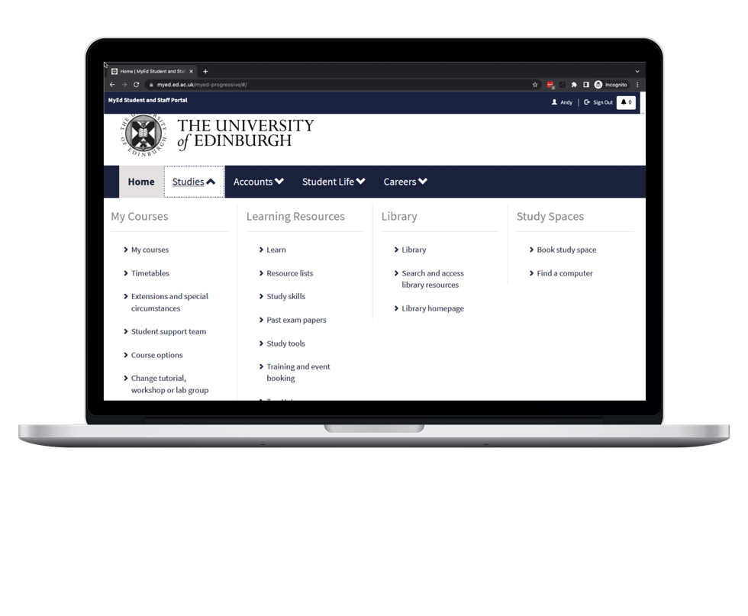
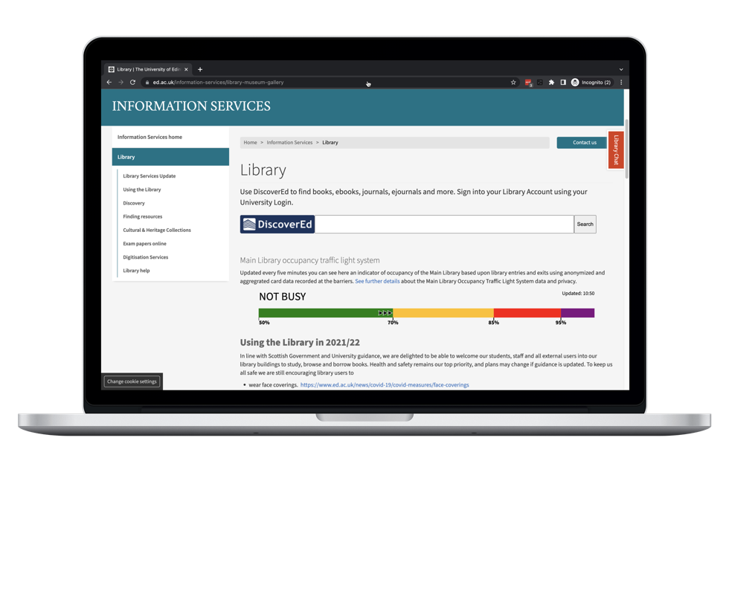
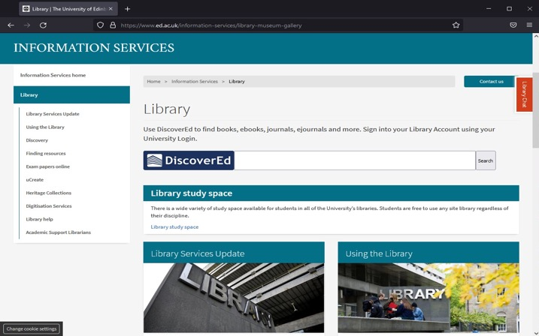
Library resources
CLICK OR SCAN
Access The Library's resources and read about all the services it provides from MyEd's Studies tab or The Library's webpages
Notes:
You can access the Library's resources and services through the University's MyEd portal, or through the Library's website.
This is the preferred route as it simplifies the access to online material such as journals and ebooks. By going through the Library's website you will be able to access all the resources available to you as a University of Edinburgh student.
On the left of this slide is a screenshot of the MyEd portal, and when you're in MyEd you'll find the relevant links are listed under the "Studies" tab.
The first link "Library" takes you to DiscoverEd, which is the Library's catalogue and discovery tool, which I'll talk about on the next slide.
The second link, "Search and access Library resources" takes you to links for frequently-used Library resources, including subject-specialist databases, and also subject guides.
The subject guides can be very useful when you want to find out more about specialist Library resources in your subject area. I would encourage you to explore the guide for your subject.
The third link points to the homepage of the Library's website. On the right of this slide is a screenshot of the homepage.
At the top of the page, you'll see a simple search box for DiscoverEd to search the Library's catalogue and discovery tool.
Further information about the University’s library resources can be found at https://www.ed.ac.uk/information-services/library-museum-gallery/finding-resources

Slide 28
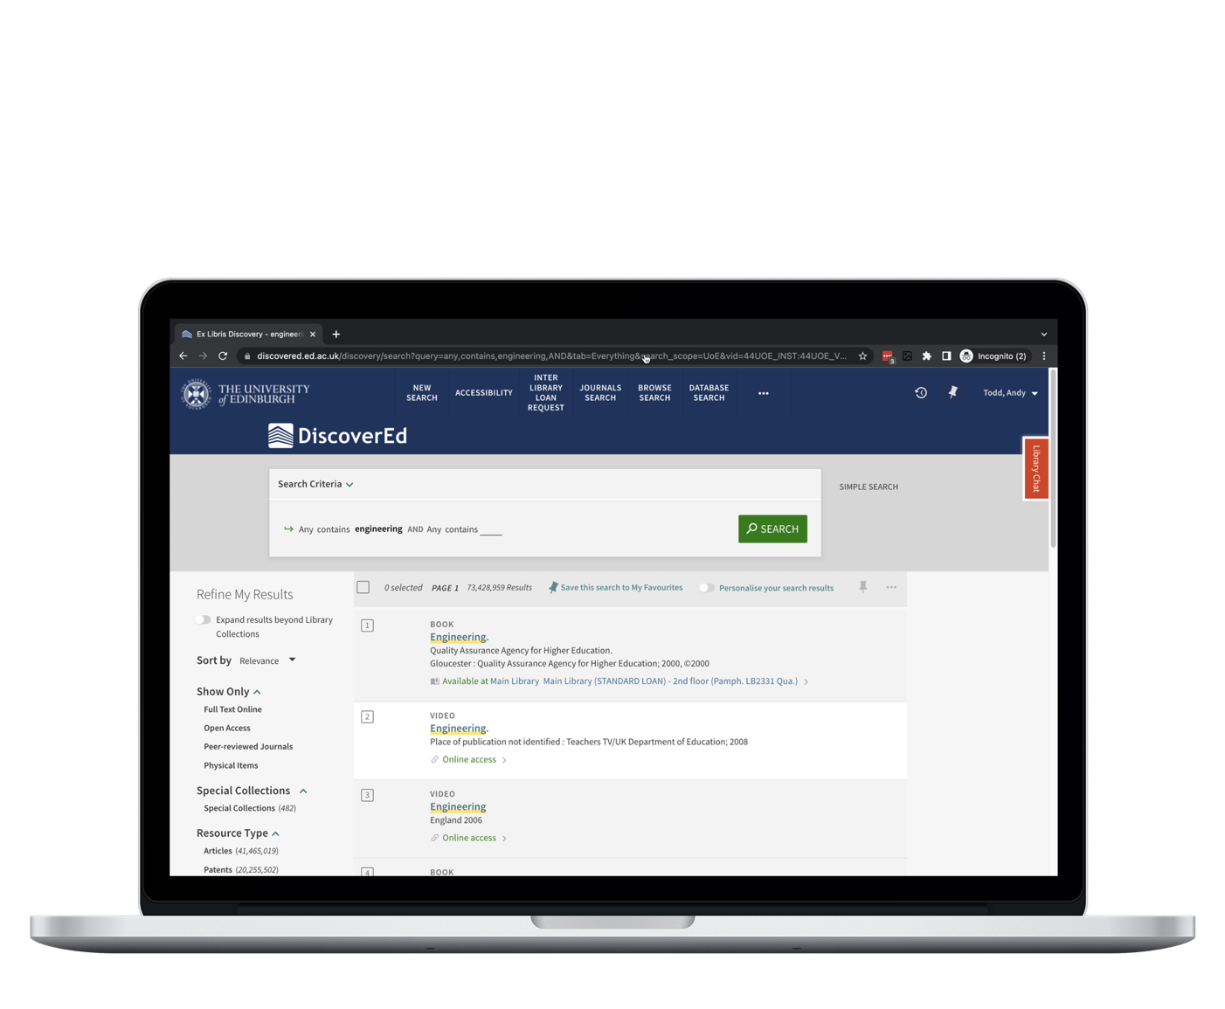
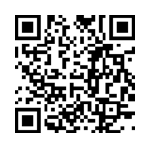
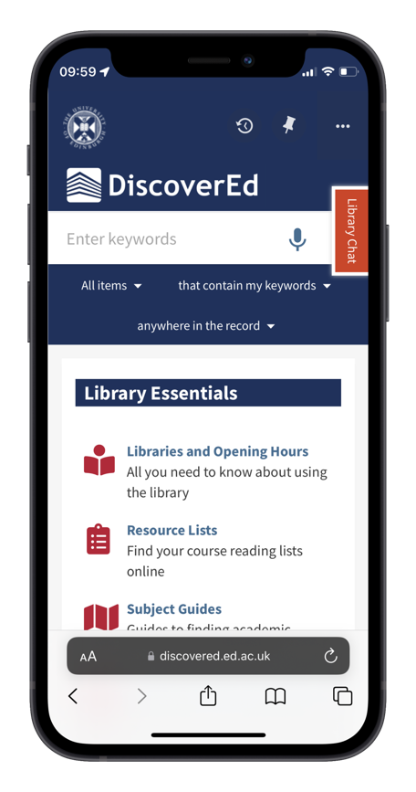
CLICK OR SCAN
DiscoverEd
The place of record for what the Library has and where to get it. Whether in print (a physical item) or online:
Books
Articles
Journals
Academic literature databases
Musical scores
Newspapers
Audio/Video materials
Theses and dissertations
Notes:
DiscoverEd is the Library's catalogue and discovery tool, so if you want to find out what print or online material the Library has, you can search DiscoverEd, for example, to see if the Library has a particular book or journal that you want to use.
This slide shows a screenshot of DiscoverEd. At the top right of the screen, there's a link to sign in to DiscoverEd using your University login.
You can use DiscoverEd without signing in first, but by signing in, you will get better access to the online resources provided by the Library. It will also allow you to access and manage your Library account, as well as save searches & links.​
Further information on DiscoverEd can be found at https://www.ed.ac.uk/information-services/library-museum-gallery/discovery

Slide 29

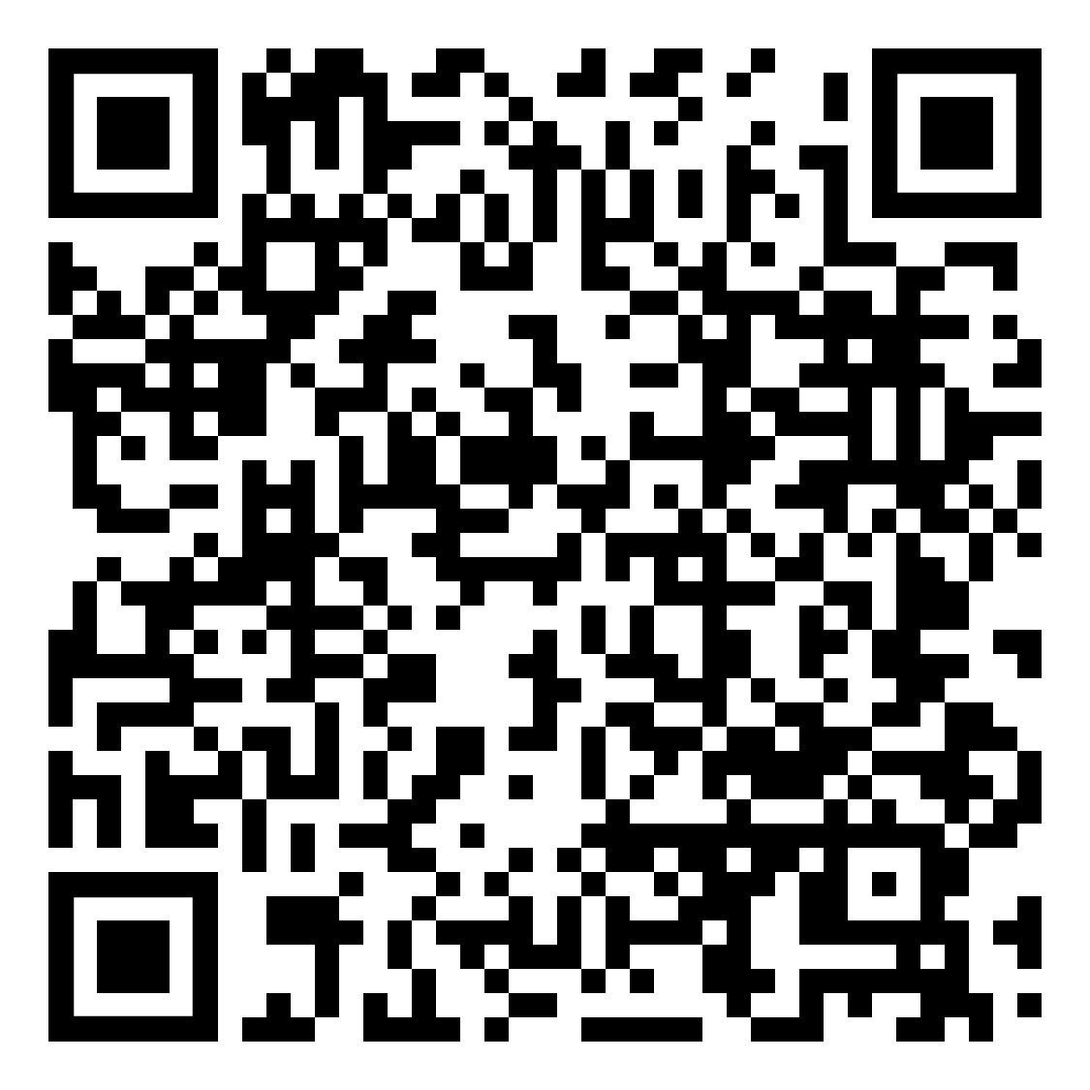
Requesting
resources
CLICK OR SCAN
If The Library's Collections do not contain what you need, services available to help you include:
Interlibrary Loans
Request a Book
SCONUL Access scheme
Please ask library staff for help on anything library-related
Notes:
There may be times when you find that you need access to material that the Library doesn't hold in its collections, but if this happens, we can usually get the material for you.
Two ways that you can request material that we don't already have, are by using our Inter-Library Loan service, or by using our Request a Book service.
To use the Inter-Library Loan service, you will need to Sign in to DiscoverEd, where you'll find a link to the Inter-Library Loan form at the top of the DiscoverEd home page.
After you complete the form, the item will usually be supplied to you within a few days, as a scan sent to your University email address. For physical items, it is likely to take longer to supply the item, so please allow plenty of time for these to arrive.
Use the Request A Book service to tell us when we do not have a book you require in our collection, and we will try to buy it for the Library.
Further information about interlibrary loans and requesting books can be found at https://www.ed.ac.uk/information-services/library-museum-gallery/using-library/request-resources

Slide 30

05
Digital
Skills
Programme

Slide 31
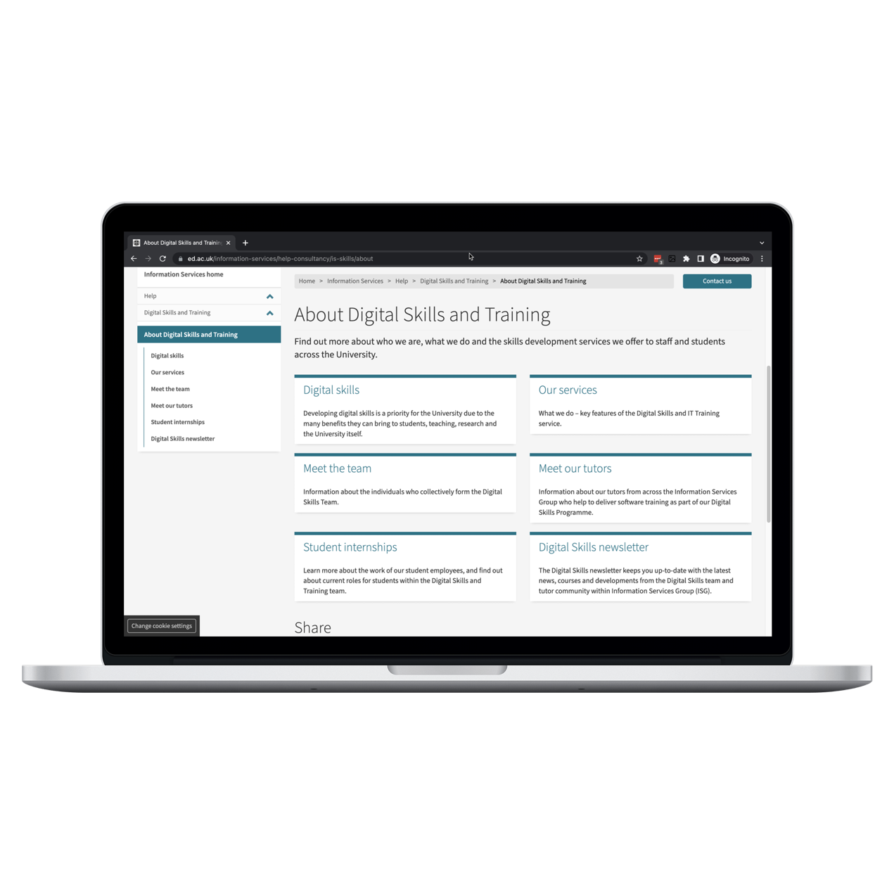
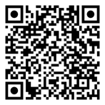
CLICK OR SCAN
About
digital skills
The University is committed to improving the digital skills of all staff and students, providing a wide range of tools and services to do this.
Notes:
Now for a few slides about the services that the digital skills team has for students.
Developing digital skills for both students and staff is a priority at Edinburgh. Although you're likely to get taught some digital skills as part of your programme this will probably be focused on your course and we advise you to further develop your broader digital skills yourself. Digital skills are important to enable you to study effectively, including searching literature, analysing data, learning in a digital environment, being more productive.
They also help you to develop graduate attributes and employability skills.
I'll talk you through some of our key student-centred services.
Further information about developing your digital skills can be found at https://www.ed.ac.uk/information-services/help-consultancy/is-skills/about

Slide 32
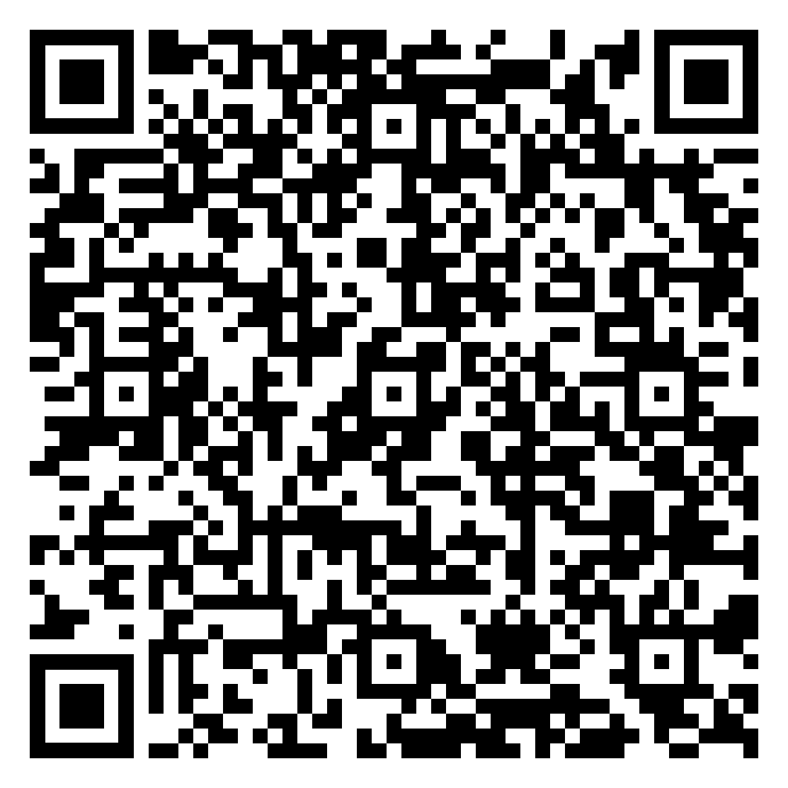
CLICK OR SCAN
Our student resources
Some of our student focused digital skills resources include:
A range of toolkits
for various degree levels
Developing Your Data Skills programme
A full programme of 100+ courses and webinars
Edinburgh Awards and
paid internship opportunities
Digital safety and
citizenship resources
Student Focus Fortnight (25 Sep
to 6 Oct) and Digital Skills Festival
Notes:
Toolkits:
A wide range of toolkits for learners of all degree types and levels
Digital Skills Programme:
A wide range of over 100 face-to-face and online webinars running all year round and accessible through the Event Booking system. Each event is completely free to attend as many times as you like. We also have two main development programmes – 23 Things and Developing your Data Skills.
Data skills: 6 month blended learning programme for students and staff to develop data skills no matter your level of prior knowledge.
23 things: Introduction to a range of digital topics and tools that are useful for your personal and professional development.
Edinburgh Awards and paid internships:
Digital Skills Specialists EA is a series of events and activities designed to strengthen your digital skills and help you stand out to employers.
Digital volunteering with Wikipedia EA helps you develop important digital research skills and apply these to improving the knowledge freely available online.
There are also a variety of student internships available both with our team and Information Services, both term time and over the summer. Opportunities will be advertised via UniTemps and MyCareerHub.
Digital safety and citizenship resources:
A range of courses and resources to help keep you safe online
Student Focus Fortnight and Digital Skills Festival:
This digital skills team is running a Student Focus Fortnight during semester 1. This will be two weeks of student-focused digital skills training events bookable via our website or Event Booking.
Our Digital Skills Festival is a week long event including interactive events, presentations, workshops and courses, delivered by speakers from within and outside of the University. It usually runs in late May.
Further information on the student resources offered by the Digital Skills team can be found at https://www.ed.ac.uk/information-services/help-consultancy/is-skills/programmes-courses-and-toolkits/student-digital-study-skills

Slide 33
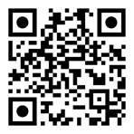
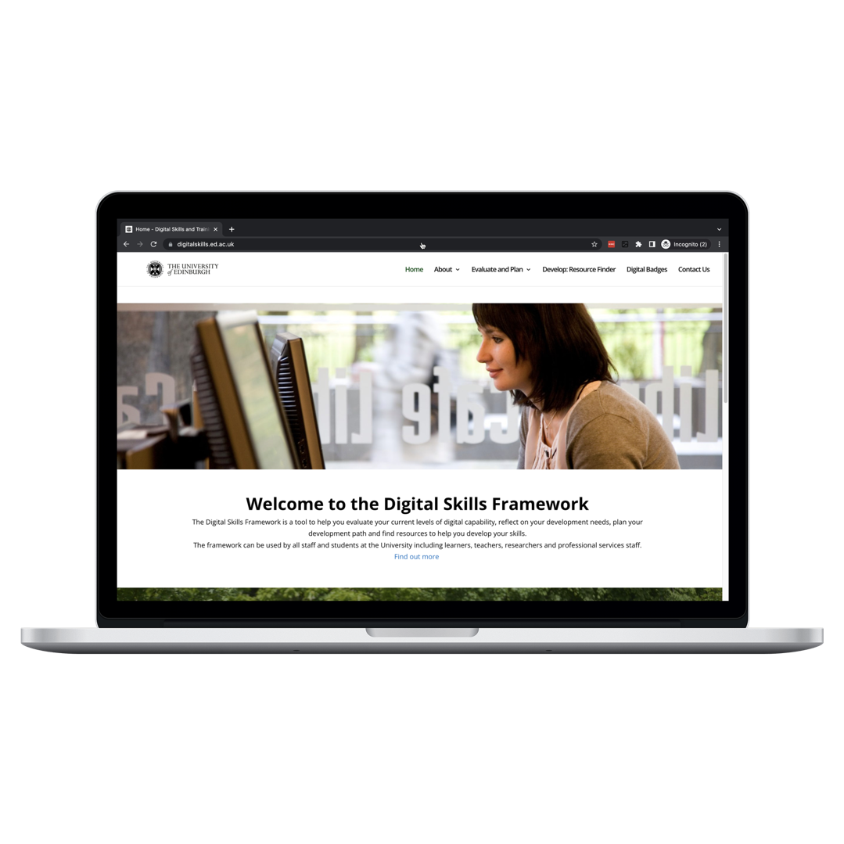
Digital Skills
Framework
CLICK OR SCAN
700+ digital skills development
services and resources in one place.
01
Self assess skills or
view role profiles.
Search for a wide
range of resources.
02
03
Develop digital skills.
Notes:
The Digital Skills Framework brings all the digital skills development services together and makes it easy for you to find the right training and resources to develop the skills you need. It will help you evaluate your current level of digital capability, plan your development path, and find resources. It contains links to the Discovery tool, the role profiles and the resource finder tool.
The discovery tool, is an online self-assessment questionnaire that helps to identify areas of strength and weakness in your own digital skills. Once you've finished, you'll receive a tailored report outlining your current digital skills competencies. You can use the report as a basis for a digital skills development plan and use the Resource Finder to search for suitable resources to get you started.
You can find out more about the Digital Skills Framework by visiting https://www.digitalskills.ed.ac.uk/

Slide 34
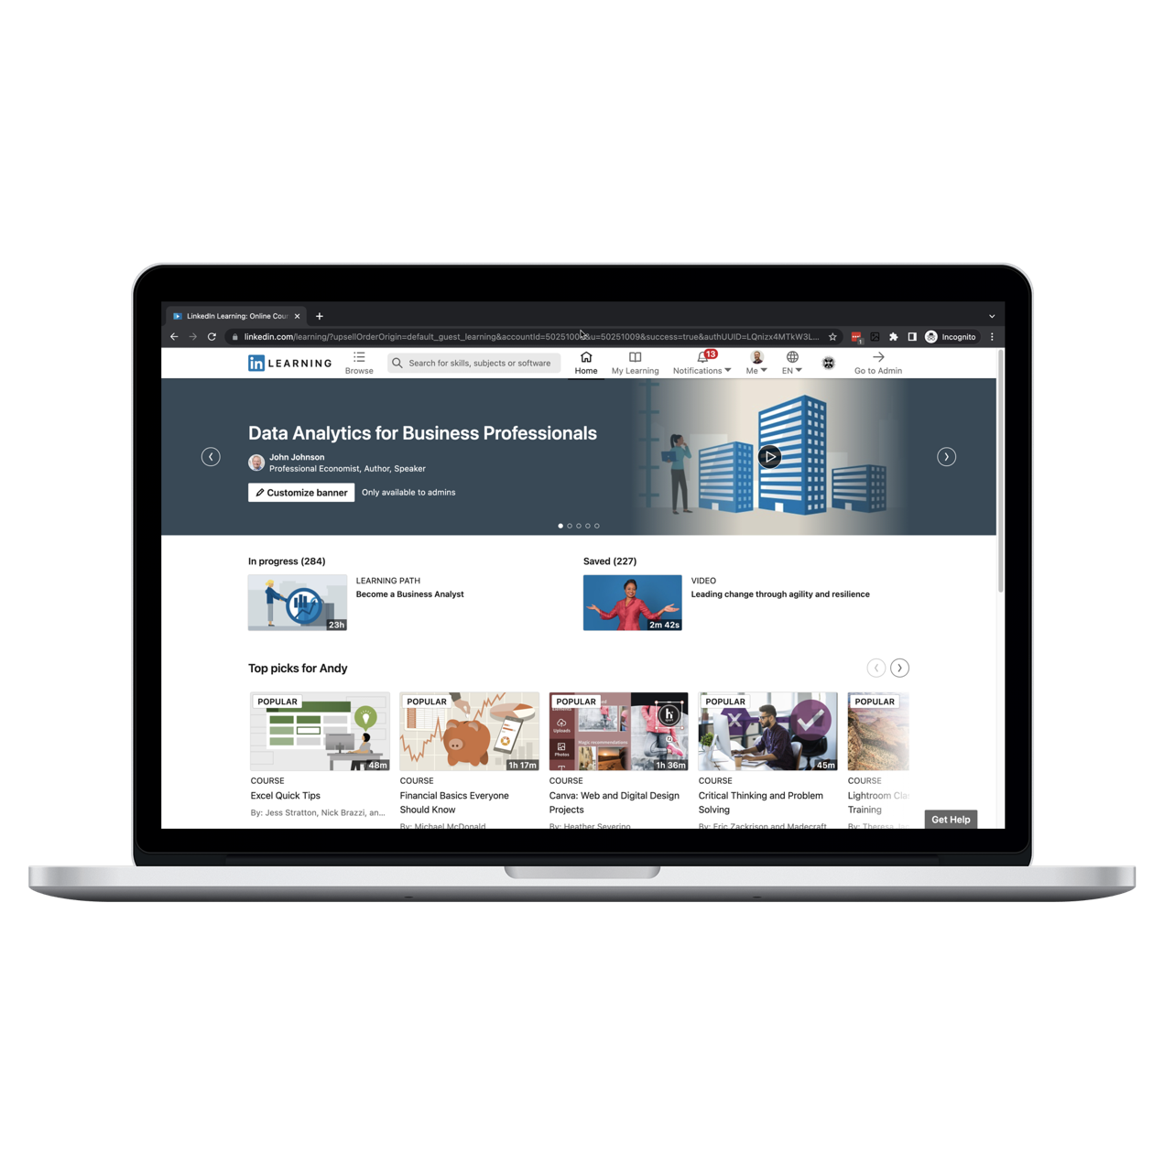
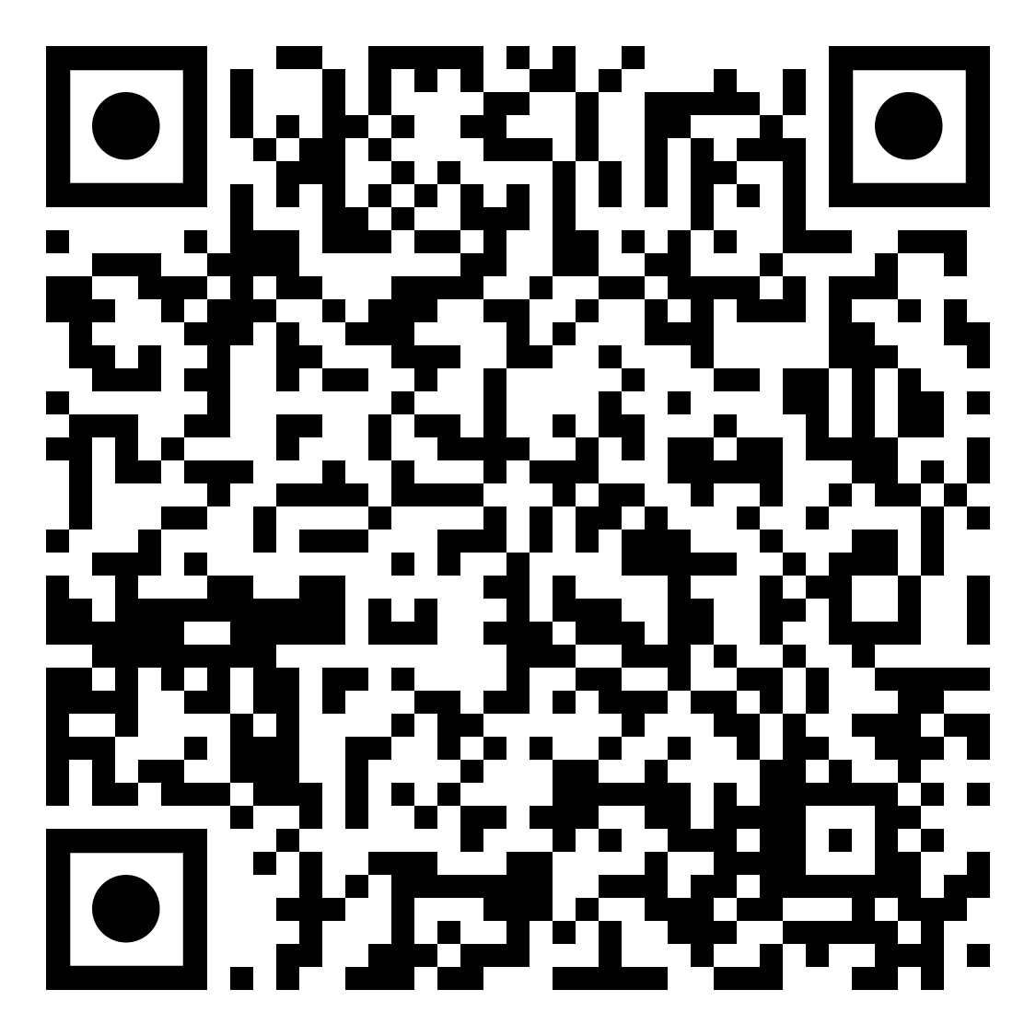
LinkedIn
Learning
CLICK OR SCAN
You have access to the world’s
leading online learning service.
18,000+ COURSES
FREE
OFFLINE VIEWING
Courses in Business, Creative and Technical skills
Free to all students during entire time at University
Download and view courses offline via
Mobile app
Notes:
LinkedIn Learning is a commercial website of online training resources that the University gives you with access to. Through the University you can get free access to over 18,000 technology, creative, and business courses developed and delivered by industry experts. You can download and view content on your desktop and mobile devices. So you can learn what you want when you want.
The courses are really wide-ranging - examples of topics include data analysis, personal branding, personal finance, leadership skills, illustration, audio engineering, graphic design, video production, programming languages to name but a few.
You can also download the mobile app and view content offline.
Find out more about the LinkedIn Learning service by visiting www.ed.ac.uk/is/linkedinlearning

Slide 35
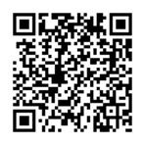
Information Security
CLICK OR SCAN
We have a dedicated information security team who provide
advice and support to help keep you safe online.
edin.ac/infosec-students
Notes:
Information security and digital safety.
This is really important - everyone is a potential target for online criminals.
5 top tips:
Keep your devices up to date and install any updates as soon as they are released. The University also provides all staff and students with free antivirus software (search website for antivirus).
Always be on the lookout for suspicious emails and phishing scams. The University will only ever send communications to your University address. Be careful opening any suspicious links and if in doubt, don’t click.
Always back up your data regularly. You can save to your University network drive or your OneDrive cloud storage account via Office 365. Both are safe, secure and backed up.
Use the University’s VPN service (registration required) when off-campus.
The University provides free access to the premium version of Last Pass to keep your passwords safe and secure. Think carefully about your passwords, avoiding the usual ‘Password’ or ’Password1234’ type passwords.
Also consider digital citizenship - think before posting on social media – don’t share personal information, but also consider how other people may react and be kind.
Support is available – you can go to the Advice Place, contact EdHelp or use the University’s Report + Support platform for reporting distressing situations related to sexual violence, harassment, domestic abuse and stalking.
There is training available in the Information Security Essentials self-enrol course on Learn; and the Digital Safety and Citizenship and Netflix: Digital Safety courses in Event Booking. More about how to book on these later.
Find out more at https://www.ed.ac.uk/infosec
Multi-Factor Authentication (MFA) is an additional layer of security that helps prevent unauthorised access to services by adding a simple verification method. This means you will be asked to verify your University of Edinburgh account using another option, such as an authenticator app code, phone call, or SMS via a second device
More information at https://edin.ac/MFAinfo

Slide 36
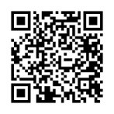
Multi-factor Authentication
          Additional layer of security for Office 365 including email
          Adds a simple verification method
          Will be rolled out in 2023/24
edin.ac/MFAinfo
CLICK OR SCAN
Notes:
Multi-Factor Authentication (MFA) is an additional layer of security that helps prevent unauthorised access to services by adding a simple verification method. This means you will be asked to verify your University of Edinburgh account using another option, such as an authenticator app code, phone call, or SMS via a second device.
Also known as ‘Two-step verification’, MFA adds an extra layer of protection to things you do online. It is used regularly for online transactions like banking, shopping and using payment websites like PayPal.
Only using one type of verification is not very secure because usernames and passwords can be easy for cyber criminals to discover, meaning your accounts can be fraudulently accessed.
MFA is a more secure approach because it requires you to verify in more than one way, as an added check to ensure you are who you say you are.
For Office 365 you already have a username and password and for MFA you need secondary verification including using
Something you have – like a mobile phone or tablet on which you can receive and respond to verification requests
For MFA to work, it should involve at least two different kinds of factors to reduce the chance of fraud. Cyber criminals may be able to discover your password but they can’t easily steal your phone as well.
More information is available at
https://edin.ac/MFAinfo

Slide 37

06
Help and
support

Slide 38
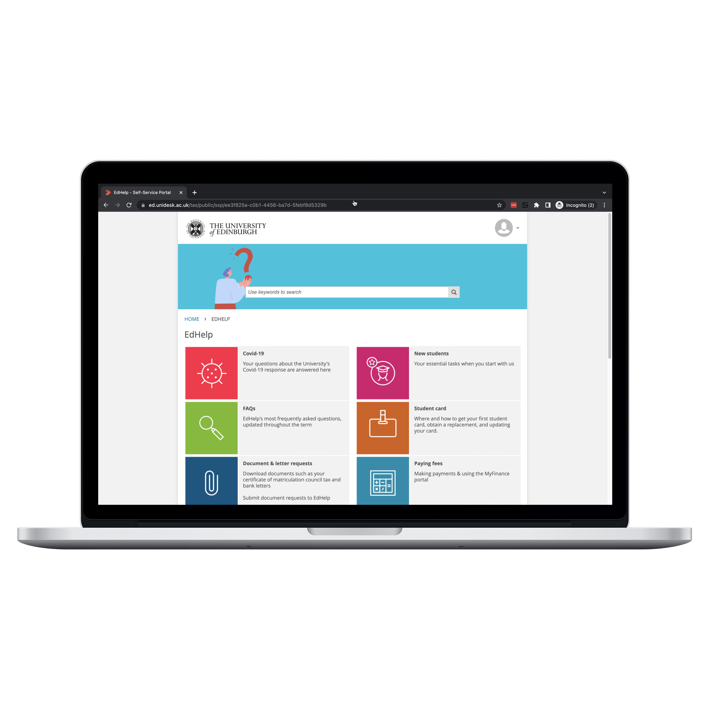
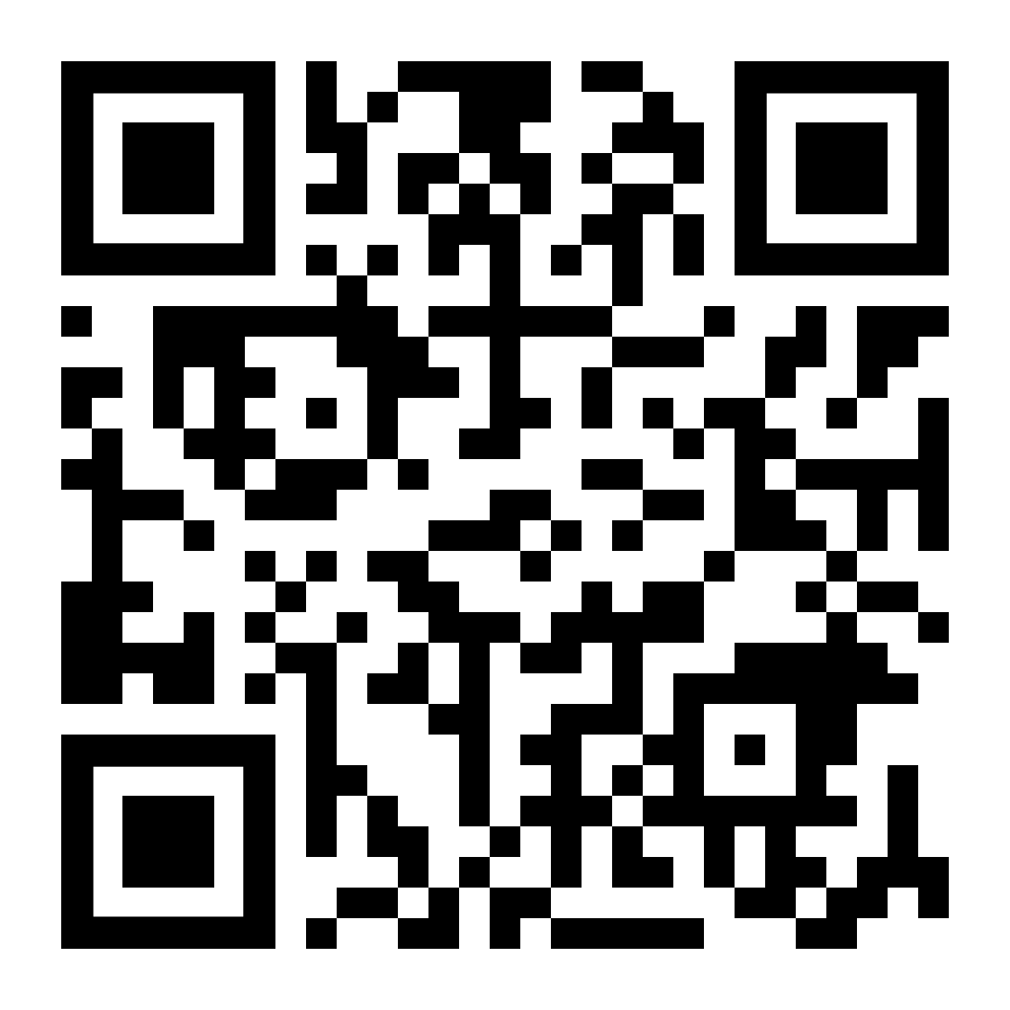
CLICK OR SCAN
EdHelp
Use EdHelp to find answers to queries related to IT support, learning and
study resources, and financial support.
Help and support is also available
from on-campus helpdesks and the
University website.
Notes:
EdHelp is a service that brings your frequently used student services together, meaning you can find what you need all in one place.
EdHelp can help with learning & study resources, IT support, financial support and much more.
Click on the ‘Launch EdHelp’ button and login with your University login to find answers to common questions and support topics.
You can use the ‘Contact Us’ form to get help with your problem, or the EdChat live chat function.
You can also visit EdHelp on-campus at the Main Library, George Square and the Noreen and Kenneth Murray Library, Kings Buildings.
Find out further information about EdHelp by visiting https://www.ed.ac.uk/edhelp

Slide 39
Thanks for
viewing
www.ed.ac.uk/is/skills
is.skills@ed.ac.uk
@uoedigiskills
Click or scan to download
this presentation or view
a pre-recorded version.
@uoedigiskills
Notes:
If you want to keep in touch with us you can subscribe to our Digital Skills Newsletter, which is sent out quarterly by email.
You can also follow us on Twitter or Instagram for updates or visit our website.
Links:
Digital Skills and Training website: www.ed.ac.uk/is/skills
Email Digital Skills and Training Team: is.skills@ed.ac.uk
Follow Digital Skills and Training on Instagram: www.instagram.com/uoedigiskills
Follow Digital Skills and Training on Twitter: www.twitter.com/uoedigiskills

Slide 40
...and our sets of editable icons
You can resize these icons without losing quality.
You can change the stroke and fill color; just select the icon and click on the paint bucket/pen.
In Google Slides, you can also use Flaticon’s extension, allowing you to customize and add even more icons.

Slide 41
Educational Icons
Medical Icons

Slide 42
Business Icons
Teamwork Icons

Slide 43
Help & Support Icons
Avatar Icons

Slide 44
Performing Arts Icons
Creative Process Icons

Slide 45
SEO & Marketing Icons

Slide 46
Nature Icons

